Slide 1
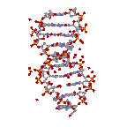
He who we are proud of
The work and living presence of Ignaz Semmelweis
Bicentenary birthday
2017/2018 Spring Semester
Ignaz Semmelweis
Pioneer of experimental pathology
Semmelweis goblet in Budapest –Semmelweis statue in Tehran
Prof. Dr. Laszlo Rosivall
Institute of Pathophysiology
PhD School of Basic and Translational Medical Sciences
International Nephrology Research and Training Center
Semmelweis University
Tehran University of Medical Sciences

Slide 2
Why is this course recommended? Why is it beneficial for you?
Semmelweis is one of the most known Hungarian medical doctor in the world
His life, achievement, tragedy and success may serve as an eternal example for the next generations
His thesises are still valid and have an impact on our life
Those who can understand the past and able to make others to understand it, they serve the future development

Slide 3
He who we are proud of
The work and living presence of Ignaz Semmelweis
Bicentenary birthday
Year 2017/2018 spring semester
Optional university course
Course leader: Dr. László Rosivall
Time: Monday, 16:30-18:00
Place: Ground Floor Hall (Tanácsterem), NET
(Lecture of April 23, Department of Public Health, NET, 21st floor, 2103-2105 room)
The aim of the course is to teach all students of Semmelweis University to learn about the life, work and present impact of the man who gave the name of our university.
On the occasion of the 200th anniversary of the birth of Semmelweis in 2018, on behalf of the Semmelweis Commemoration Committee, I announce the course for the first time in order to strengthen the knowledge, understanding and commitment of our students.
The lecturers of the course are the most outstanding Hungarian Semmelweis experts who, besides the history of his discovery, analyze the reasons behind the denial of scientific results, the professional, historical and social background, and that true scientific values ultimately occupy their worthy place despite all despairs.
The study and understanding of Semmelweis' life history, teachings and their fate is a vital human and professional duty for all medical practitioners.

Slide 4
Ignaz Semmelweis- pioneer of experimental pathology - The Semmelweis goblet in Budapest – The Semmelweis statue in Teheran (László Rosivall)
2. The history of discovering Semmelweis (Zoltán Papp)
The contemporary reception of the discovery of Semmelweis, from Vienna to London (Zoltán Papp)
Semmelweis in Pest, presentation– walk (László Molnár)
Becoming an icon - the remembrance of Semmelweis following the 19th century (Benedek Varga)
The memory of Semmelweis in the art of theatre (Emil Monos, Károly Mécs)
The ouvre of Semmelweis in the Memory of the World Register - UNESCO (Miklós
Réthelyi)
Semmelweis-related memories, paintings, statues in the world and the Carpathian Basin (Imre Romics)
8. Semmelweis in the family – great-great grandson (Kálmán Hüttl)
9. Childbed fever from Hippocrates to the present (Nándor Ács)
10. Semmelweis – Pasteur – Hőgyes: bacteriology in the second half of the 19th century (Károly Nagy)
11. The history, efficiency and present-day hitches of handwashing (József Sándor, Tamás
Haidegger), Exam

Slide 5
What are we talking about?
Study
Research work
Discovery
Consequence
In Pest
Disease and death
Refusal
Deification
Semmelweis chalice
Semmelweis starts to East
SE-200 Memorial Committee
Plans
Semmelweis, theatre performance premiere
János Áder, president of Hungary
Clean hands’ movement

Slide 6
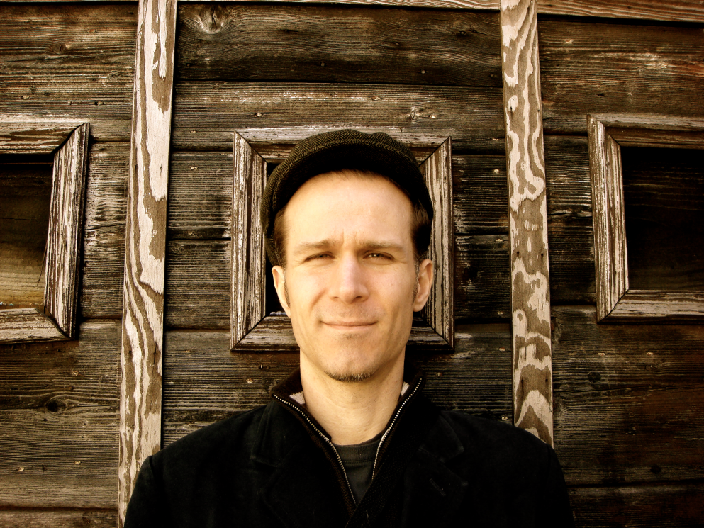
Ray Lustig , music composer, New York
Semmelweis opera, 2017, September 11. New York
Awards include the Charles Ives Fellowship from the American Academy of Arts and Letters, ASCAP’s Rudolf Nissim Prize for his orchestral work UNSTUCK, and the Aaron Copland Award from Copland House.
https://soundcloud.com/ray-lustig/semmelweis-live-at-the-nac-medley-of-clips?in=ray-lustig/sets/sample-demos-from-semmelweis

Slide 7
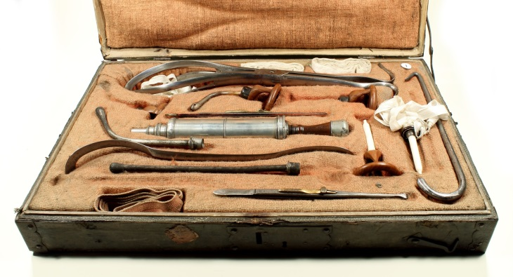
Ignac Semmelweis
Doctor of Medical Sciences and Surgery, Master of Obstetrics at the Pest Royal Hungarian University of Sciences,
Professor of Practical Obstetrics
„Savior of mothers and newborns,
who overcame the disease
but could not convince the people”!
Obstetrician surgical set from the time of Semmelweis

Slide 8
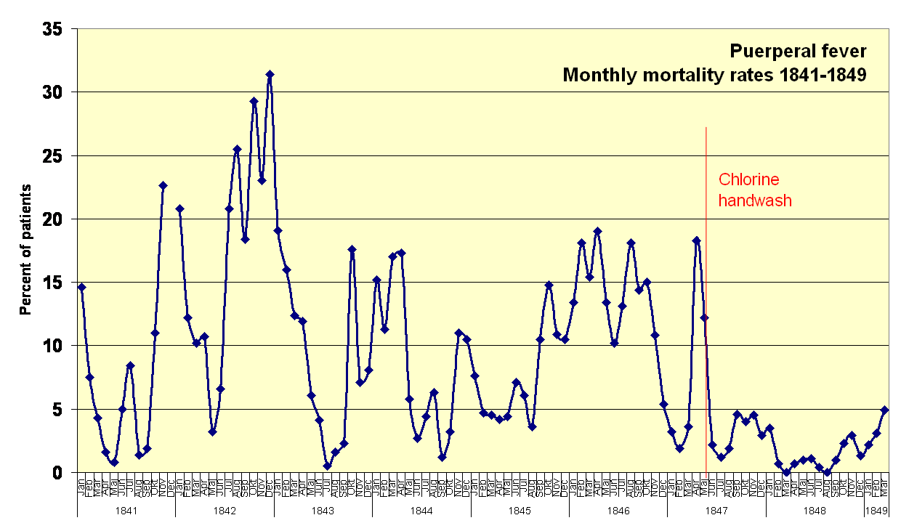
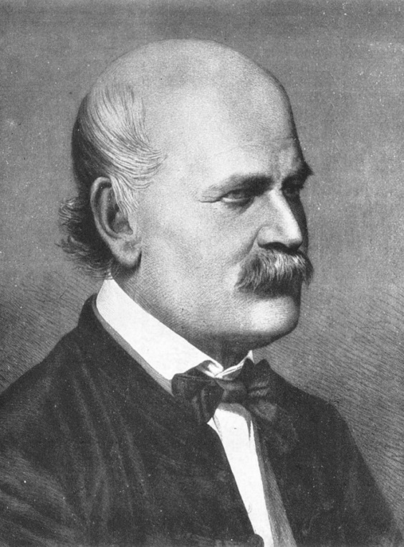
- The printed materials on the discovery of the causes of childbed fever (1847-1861) is inscribed in Memory of the World Register of United Nations Educational, Scientific and Cultural Organization. - UNESCO has included the 150th anniversary of Ignaz Semmelweis’ death in the list of notable anniversaries celebrated in 2015.
Ignaz Semmelweis
1818-1865
Puerperal fever mortality rates (Vienna Maternity Institution 1841–1849).
Rates drop when Semmelweis implemented chlorine hand washing 1847.

Slide 9
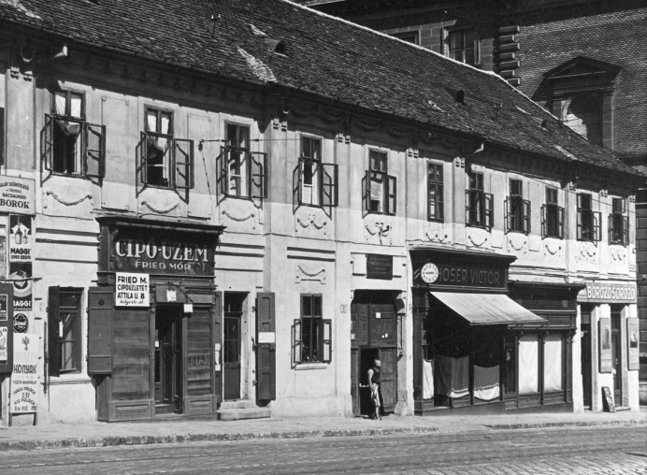
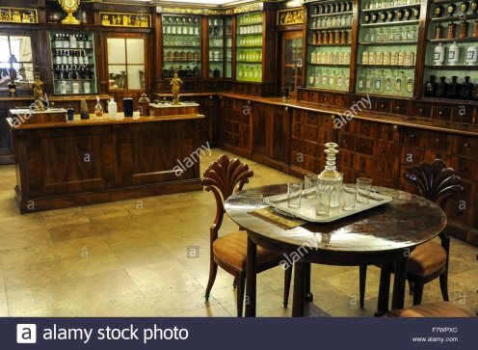
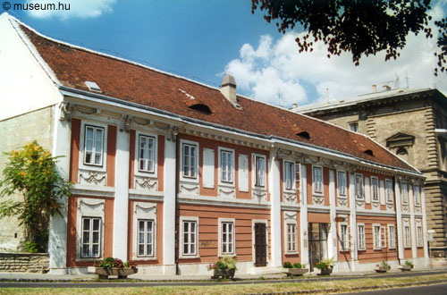
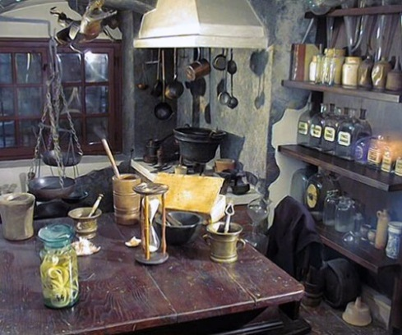
Semmelweis’ birthplace, above the door a plaque placed in 1906 (old photo)
Semmelwies Museum today

Slide 10
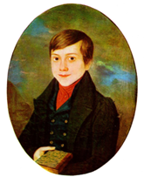
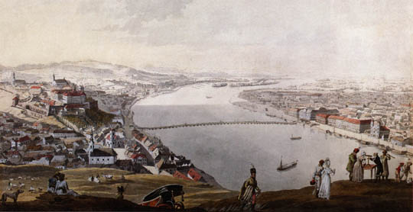
Curriculum vitae
Birth: July 1st ,1818 in Buda to a German speaking family, fifth child of 10.
Name: family names registered in 7 different forms, there are no „w”,
„mm” among them.
Studies: High School, in Castle of Buda, eminent even in Hungarian
University (Vienna): 1837 law student
1838 medical student
1844 MD.
1844 obstetrician
1845 surgeon
Work: Obstetrics Department, Vienna University 1844-1850
Discovery 1847 (29 years old)
Head of Obstetrics, Rókus Hospital, Pest 1851-1855
Professor of Obstetrics University of Pest 1855-1865
Death: 1865, Vienna
Buda, 1818

Slide 11
Research work

Slide 12
From the very first moment he dedicated his life to overcome puerperal fever!
„… The cases, in which the obstetrician could intervene effectively, are incomparably negligible compared to the number of victims, that is, compared to the cases, when the intervention was unsuccessful. This dark side of obstetrics is puerperal fever ... I considered not just the therapy to be insufficient, but also the knowledge incomplete, because
I have not found any explanation for its true cause in the presently valid aetiology of puerperal fever.”
(He was just about 25 years old)
(Semmelweis Ignác Fülöp: A gyermekágyi láz kóroktana, fogalma és megelőzése (Puerperal fever, aetiology, concepts and prevention). P 9,
Translated by: Rákóczi Katalin, Akadémiai Kiadó, Budapest, 2012. Original edition: Die Ätiologie, der Begriff und die Prophylaxis des Kindbettfiebers
von Ignaz Philipp Semmelweis. Pesth-Wien-Leipzig, C.A. Hartleben Verlag1861)

Slide 13
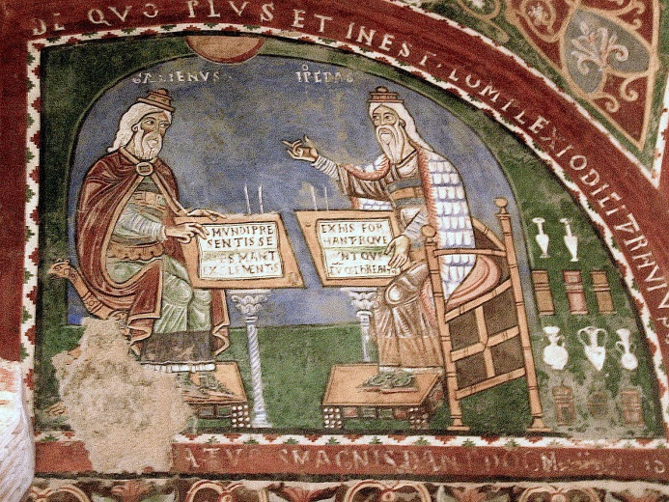
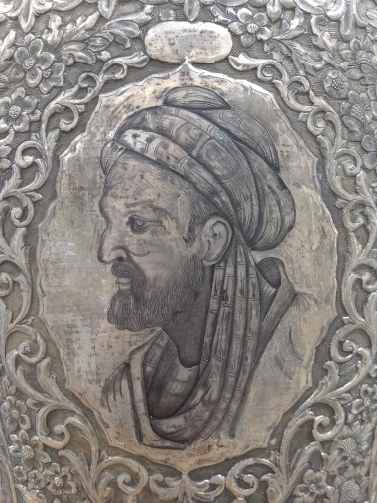
The disease was already recognized and described by
Hippocrates of Kos
460-370 BC
Galenus of Pergamon
129-210 AD,
Avicenna
(Ibn Sīnā or Abu Ali Sina)
980-1037
Mural painting showing Galenus and Hippocrates.
12th century; Anagni, Italy
Avicenna Portrait on Silver Vase - Museum at BuAli Sina
(Avicenna) Mausoleum - Hamadan - Western Iran

Slide 14
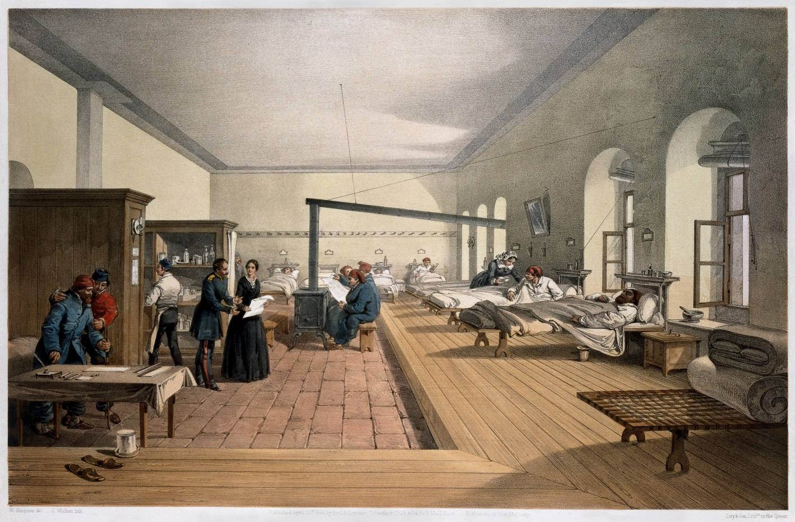
A ward of the hospital at Scutariwhere Florence Nightingale worked and helped
to restructure the modern hospital opened 1860
But peurperal fever remained sporadic until XVIII-XIX century, when the „modern” hospitals appeared in greater number

Slide 15
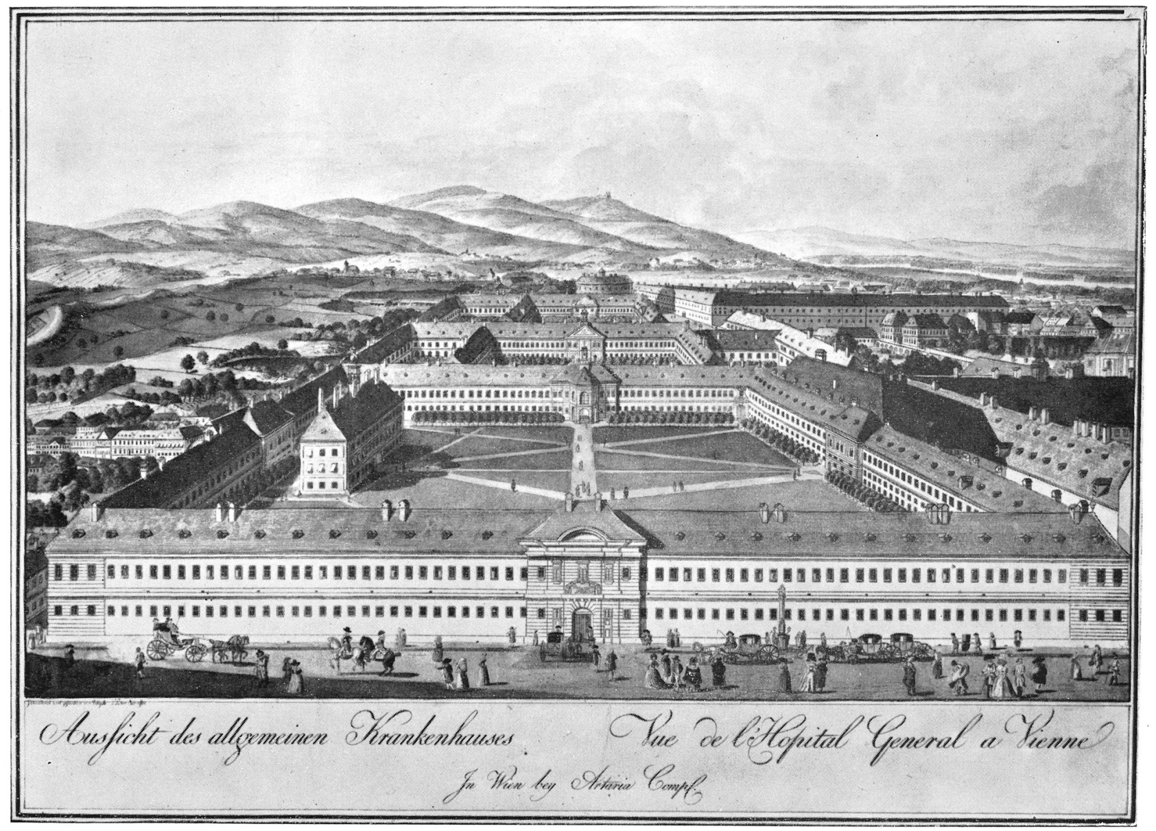
Vienna General Hospital in 1784. Semmelweis worked at the maternity clinic. Copper engraving by Josef & Peter Schafer
Role of Coincidence, there were two Departments, 1 and 2. In 1st: midwives, in 2nd: doctors and medical students practiced.

Slide 16
Semmelweis wrote on the statistics of the two departments
Published in the „Orvosi Hetilapban” (Medical Weekly, 1858)
„In both wards, there were about the same number of births,
(~ 3000).
However, in many years the rate of death is very different:
in the ward where midwives worked, the death rate was low not more than 60 per year,
while the physicians worked, the death was about 600-800.”
(Orvosi Hetilap, 1.sz. pp 1-2, 1858)

Slide 17
On the way of doubts and burn-out…
„…the more favourable health conditions of the Second Department of Obstetrics (as compared to the First Department) made me think that the employees of the Second Department are either more clever and more careful in performing their duties than we were.
The disrespect of the personnel against the employees of the First Department of Obstetrics resulted in such an unhappy mental state that it truly embittered my life. Everything was in question, everything seemed unclear, everything was doubtful only the number of deceased remained undoubtedly steady.”(page 46)
(Semmelweis Ignác Fülöp: A gyermekágyi láz kóroktana, fogalma és megelőzése (Puerperal fever, aetiology, concepts and prevention). P 47, Translated by: Rákóczi Katalin, Akadémiai Kiadó, Budapest, 2012. Original edition: Die Ätiologie, der Begriff und die Prophylaxis des Kindbettfiebers von Ignaz Philipp Semmelweis. Pesth-Wien-Leipzig, C.A. Hartleben Verlag1861)

Slide 18
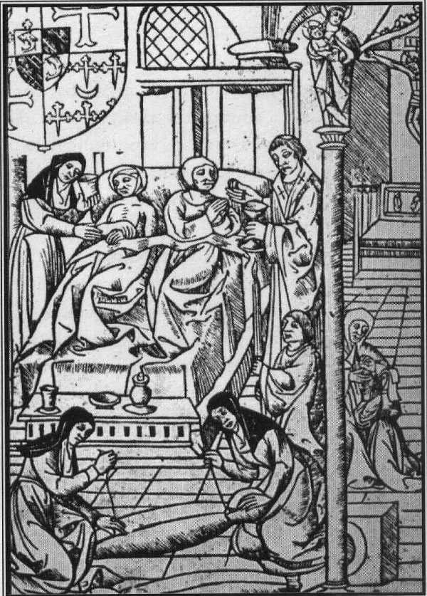
Explanations of cause of puerperal fever at that time
Retention of lochia (febris lochialis)
Retention of placenta
Milk-theory, trans-shipment into the pelvis
Phlogistic theory: inflammation of abdominal organs, intestine
Hospital miasma, atmospheric telleric hazards
- Puerperaltyphus
Exhaustion, tiredness,
Bell of priest,
Over-crowded hospital wards,
Too much sexual enjoyment, etc.
Hôtel Dieu in Paris, about ad 1500. The priest on the right is issuing the last sacraments, while a nun administers to the patient on the left. Patients often slept two, three and even four to a bed

Slide 19
Era of Autopsy
In Vienna the famous, Moravian-born anatomist Rokitansky, in practice, spread Morgany’s view - contrary to the earlier empirical patient care . According to this post-mortem approach, it is possible to find a therapy for the cause only after the anatomical and morphological changes have been found.
The tragicomic feature of this important principle is: first the patient has to die, and it is only after that one can make an accurate diagnosis and cure the disease effectively.
Due to spreading of this approach, the number of autopsies increased dramatically and to an unbelievable extent in all medical areas.

Slide 20
Pioneer of Epidemiology Research
Methodology of Semmelweis
Statistics, Statistics, Statistics
Observation, Comparison
Autopsy, Autopsy, Autopsy

Slide 21
From observations, and data analysis
Semmelweis could conclude:
„..congestion did not play a role" (page 31).
neither the seasons, climatic conditions, fear nor poverty were responsible
the climatic conditions did not differ between the two departments
omitting ringing the bell did not help
mortality rate was not high among the poor mothers having already given birth who were admitted from the streets.
in the cases of premature babies, where vaginal examination by the physician did not take place because of the rapid process, the number of cases of puerperal fever was significantly less
In the autumn of 1846 ,he came to the decision of announcing that puerperal fever was not an „epidemia” i.e. general epidemic, but „endemia”

Slide 22
In spring 1847, Semmelweis recieved a sad news. His revered and highly esteemed Kolletschka, professor of forensic medicine - after one of his students pricked him with his knife during autopsy – got ill with phlebitis and lymphangitis as well as bilateral pleuritis, pericarditis, peritonitis, cortico-cerebral inflammation and died.
„…Due to my excitation over Kolletschka's death, the recognition rushed into my mind with uncontrollable force: Kolletschka deceased of the same condition as the several hundred with puerperal fever I saw to die. The mothers also died of phlebitis, lymphangitis, peritonitis, pleuritis and pericarditis and cortico-cerebral inflammation.” (1847)
Cadaver toxins, cadaver parts, septicemia!
(Semmelweis Ignác Fülöp: A gyermekágyi láz kóroktana, fogalma és megelőzése (Puerperal fever, aetiology, concepts and prevention). P 47,
Translated by: Rákóczi Katalin, Akadémiai Kiadó, Budapest, 2012. Original edition: Die Ätiologie, der Begriff und die Prophylaxis des Kindbettfiebers
von Ignaz Philipp Semmelweis. Pesth-Wien-Leipzig, C.A. Hartleben Verlag1861)

Slide 23
„To destroy the substance of the corpse stuck to the hand – around the middle of 1847, I do not remember the day exactly - I used chlorina liquida, this was the liquid my students and I had to wash hands with before the examinations.”
The next seven months the death rate substantially decreased
Year, 1847 | Number of delivery | Number of death | %
June | 268 | 6 | 2,38
July | 250 | 3 | 1,20
August | 264 | 5 | 1,89
September | 262 | 12 | 5,23
October | 278 | 11 | 3,95
November | 246 | 11 | 4,47
December | 273 | 8 | 2,93
 | 1841 | 56 | 3,04
Semmelweis Ignác Fülöp: A gyermekágyi láz kóroktana, fogalma és megelőzése (Puerperal fever, aetiology, concepts and prevention). P 47
Translated by: Rákóczi Katalin, Akadémiai Kiadó, Budapest, 2012. Original edition: Die Ätiologie, der Begriff und die Prophylaxis des Kindbettfiebers
von Ignaz Philipp Semmelweis. Pesth-Wien-Leipzig, C.A. Hartleben Verlag1861)

Slide 24
Indeed, the doctors and medical students in Vienna did not wash their hands in that time, or did not wash enough and did not even think about its importance?
?!

Slide 25
Advices for midwives in early XIX century
„The midwife should keep herself clean, she must not touch the mother with a wounded hand. After each birth, she must wash her hands with vinegar, then soap. In case the mother has a contagious illness, the midwife must cover her hands with fresh oil, butter, or lard before birth, and after birth wash them with water containing ash, then alkaline water, and finally soapy water. After that she may go on to the next mother, again rinsing her hands in soft, lukewarm water containing bran before proceeding.”
DIETETICS: Regulations to Maintain Health and Prevent Disease, written and published by János Zsoldos, physician and judge, member of multiple scientific societies, First Official Doctor of the Great Noble County of Veszprem. Pg. 197-198, 2nd edition, Trattner Press, Pest, 1818.

Slide 26
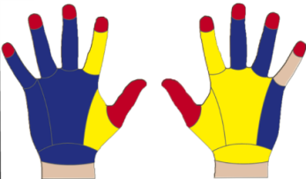
XIX. sz.
Semmelweis states
„The school in Vienna prepares the students with many autopsies for high standards, they washed their hands, however, the bad odor of their hands revealed that the hand-washing was not effective.
This kind of invisible, odorous parts of the cadaver were transported to the vagina during obstetrics examinations.”
Orvosi Hetilap, 2.sz. p 18-19, Pest, 1858
XXI. sz.
HandinScan
„Noncompliance with hand hygiene guidelines remains a collective challenge…”
Am J Infect Control. 2015 Mar 1;43(3):269-74

Slide 27
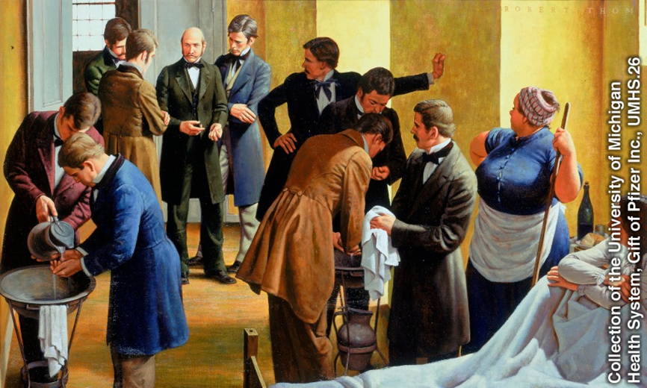
Successful prevention! Was it enough!?
„In 1848, when we kept strictly to washing hands in the chlorine-lime, only 45 out of 3556 i.e. 1.27% children died.”
Semmelweis Ignác Fülöp: A gyermekágyi láz kóroktana, fogalma és megelőzése (Puerperal fever, aetiology, concepts and prevention). P 51
Translated by: Rákóczi Katalin, Akadémiai Kiadó, Budapest, 2012. Original edition: Die Ätiologie, der Begriff und die Prophylaxis des Kindbettfiebers
von Ignaz Philipp Semmelweis. Pesth-Wien-Leipzig, C.A. Hartleben Verlag1861)

Slide 28
Result of the Great Discovery
World-wide recognition, only late
Dismissal, immediatelly

Slide 29
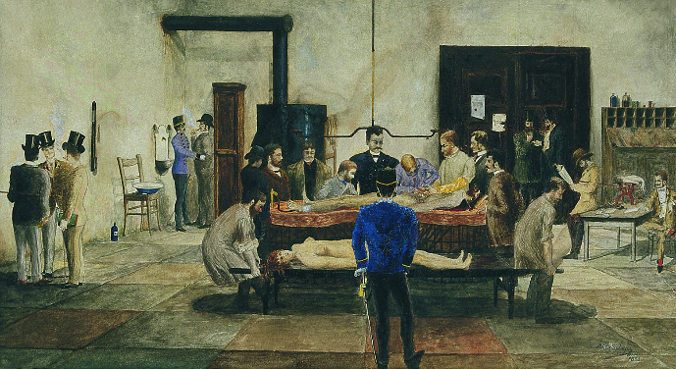
What about Semmelweis’ feelings?!
„Due to my conviction I must admit, solely God alone knows how many people have died prematurely because of me, too. I dealt more with corpses than the other obstetricians generally did.”
Nékám Lajos, id. (1868-1957): Autopsy. 1888. (tempera)
Semmelweis Ignác Fülöp: A gyermekágyi láz kóroktana, fogalma és megelőzése (Puerperal fever, aetiology, concepts and prevention). P 65,
Translated by: Rákóczi Katalin, Akadémiai Kiadó, Budapest, 2012. Original edition: Die Ätiologie, der Begriff und die Prophylaxis des Kindbettfiebers
von Ignaz Philipp Semmelweis. Pesth-Wien-Leipzig, C.A. Hartleben Verlag1861)

Slide 30
Animal experimental model of puerperal fever
Pioneer of Clinical Pathophysiology
Rabbits (n=9) after delivery have been treated with exudation of infected myometrium, pleura, peritoneum, etc
„The same changes were found in the corpses of rabbits as in the people who died of puerperal fever or who ultimately died of pyaemia.”
Semmelweis Ignác Fülöp: A gyermekágyi láz kóroktana, fogalma és megelőzése (Puerperal fever, aetiology, concepts and prevention). P 65,
Translated by: Rákóczi Katalin, Akadémiai Kiadó, Budapest, 2012. Original edition: Die Ätiologie, der Begriff und die Prophylaxis des Kindbettfiebers
von Ignaz Philipp Semmelweis. Pesth-Wien-Leipzig, C.A. Hartleben Verlag1861)

Slide 31
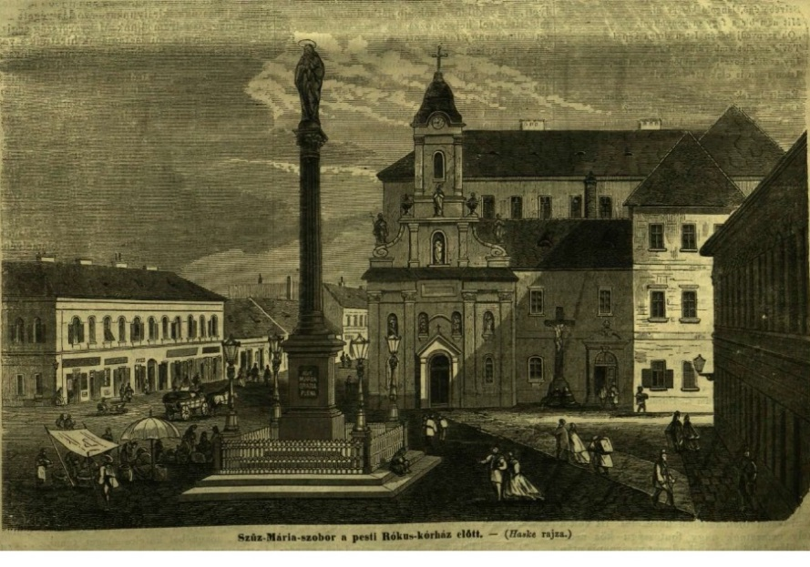
Leaving Vienna
Reception in Rokus Hospital;
rejection, skepticism of the colleagues in Pest, too
„In the St. Rokus Hospital right now, just like every year, a heavy puerperal fever prevails, although there are not any investigating medical students, whose hands were infected with decomposed organic materials.” - colleagues
Semmelweis Ignác Fülöp: A gyermekágyi láz kóroktana, fogalma és megelőzése (Puerperal fever, aetiology, concepts and prevention). p 66,
Translated by: Rákóczi Katalin, Akadémiai Kiadó, Budapest, 2012. Original edition: Die Ätiologie, der Begriff und die Prophylaxis des Kindbettfiebers
von Ignaz Philipp Semmelweis. Pesth-Wien-Leipzig, C.A. Hartleben Verlag1861)

Slide 32
Semmelweis response
„.. this is not inconsistent, but actually is in line with my opinion on the management of puerperal fever. I managed to find out by my closer investigation that the obstetrics department of St. Rokus Hospital is not an independent department, but it is subordinated to surgery. The obstetrician chief doctor is the surgery chief doctor as well as the doctor of forensic medicine at the same time. In addition, in the absence of a pathologist the autopsy is performed by the chief doctors of the departments themselves."
Semmelweis Ignác Fülöp: A gyermekágyi láz kóroktana, fogalma és megelőzése (Puerperal fever, aetiology, concepts and prevention). p 66,
Translated by: Rákóczi Katalin, Akadémiai Kiadó, Budapest, 2012. Original edition: Die Ätiologie, der Begriff und die Prophylaxis des Kindbettfiebers
von Ignaz Philipp Semmelweis. Pesth-Wien-Leipzig, C.A. Hartleben Verlag1861)

Slide 33
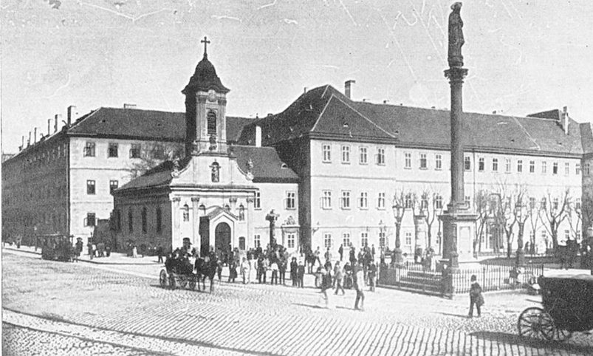
He become the Head of the Obstetrics Department
in Rokus Hospital (1851-1857)
933 deliveries and only 8 puerperal fevers (0.85%!)
In 1855, he become the Professor of Theoretical and Practical Obstetrics of University Pest

Slide 34
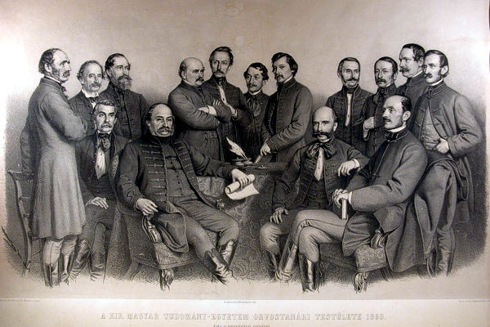
The Professors of Medical Faculty of University Pest , 1863
Left:: Diescher János, Wágner János, Arányi Lajos, Semmelweis Ignác, Lippay Gáspár, Lenhossék József, Jendrassik Jenő, Nedelkó Döme, Linzbauer Ferenc, Wachtel Dávid, Stockinger Tamás. Sitting: (left): Zlamál Vilmos, Sauer Ignác, Rupp N. János és Balassa János

Slide 35
„The laws of highest rank on requirements of hospital equipment prescribe four square fathoms for each bed. As the Clinic of Obstetrics has 26 beds, in compliance with the highest order it ought to possess 104 square fathoms, whereas it only has 41, in addition, there is no room, in which the large numbers of students and midwives could be placed.
Between the spaces of the windows of two rooms, three chimneys of the chemistry laboratory are situated, by which, if there is fire in certain stoves, the temperature is unbearably elevated.
The position of the Clinic of Obstetrics is as follows: two windows are facing the northern and six of them are facing the western courtyard. The northern blind court is five feet wide, the bare wall of the neighbouring building rose up to the height of the windows of the Clinic of Obstetrics. In this blind courtyard on the ground, on the first and second floor closets are situated.
On the ground floor joining to the closets, the cesspool of the building is located spreading penetrating smell of its rotting contents. The ground floor premises are taken by the elementary and pathological anatomy and just below the windows of Obstetrics, the drainage canal is found, into which all the fluids of the pathological departments are drained. The first floor is dominated by the premises of chemistry. In the corner, where the northern and western courtyards are bordering, the morgue of the clinics can be found.”
Semmelweis Ignác Fülöp: A gyermekágyi láz kóroktana, fogalma és megelőzése (Puerperal fever, aetiology, concepts and prevention). p 68,
Translated by: Rákóczi Katalin, Akadémiai Kiadó, Budapest, 2012. Original edition: Die Ätiologie, der Begriff und die Prophylaxis des Kindbettfiebers
von Ignaz Philipp Semmelweis. Pesth-Wien-Leipzig, C.A. Hartleben Verlag1861)

Slide 36
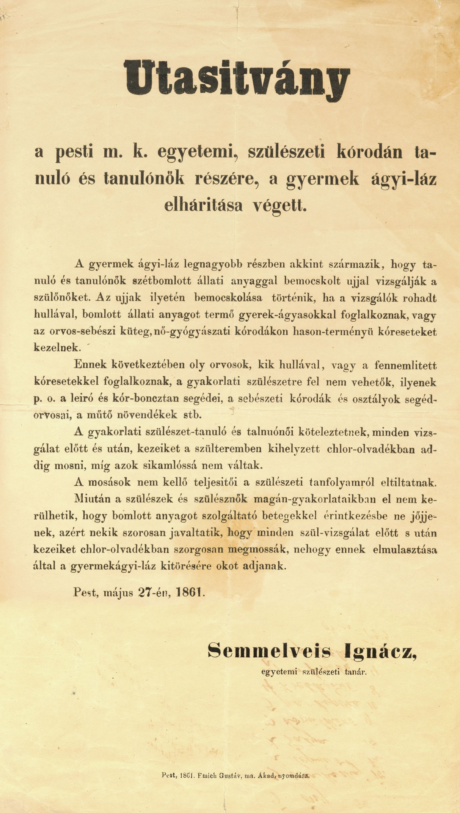
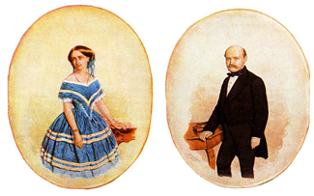
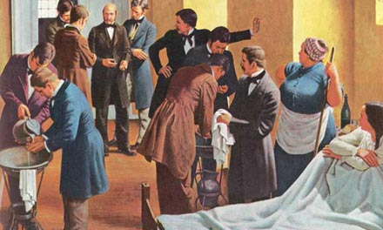
Semmelweis with his wife
at work

Slide 37
His illness and death

Slide 38
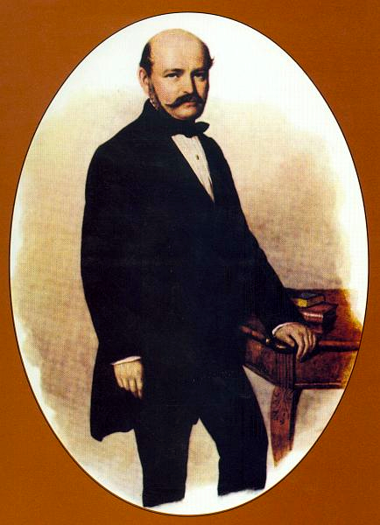
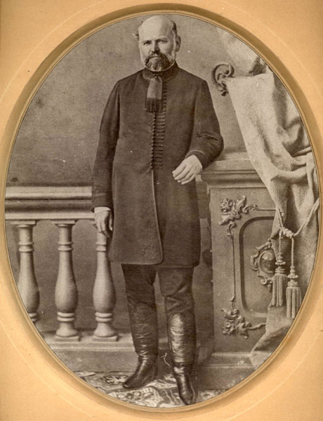
Pictures of Semmelweis in his age of 39 and 46
1857 (A. Canzi painting)
1864

Slide 39
His disease
He had syphilis and the neural involvement altered his thinking, motion and behaviour already in the last 5 years of his life.
His routine work was properly done, but scientific progress, private life, sexual habits changed, he suddenly grew older, sleep disturbances, temper tantrums also occurred.
Whether his numerous injuries described in his autopsy report (1865) are the consequences of his uncontrolled behaving or the harsh care habits of that time, we do not know. But we do know that his days were limited, even without the injury and sepsis.

Slide 40
His refusal and forgetness
Change name in his family
Concealment of his doctrines,
Concealment of his hospital records until 1977(!)
International resistance

Slide 41
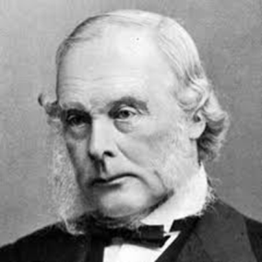
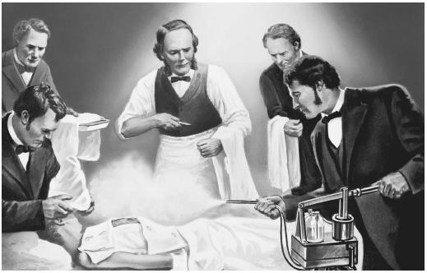
Semmelweis managed to beat the disease,
but did not succeed in convincing the age!
„Nearly 40 years after announcement of Semmelweis doctrines in 1885, Lister was seen to leave his car, to perform a surgary without washing his hands and only using abundant carbolic acid solutions.”
Lister in theatre
Csillag I.: A Semmelweis-koncepció egy előzménye a magyar orvosi irodalomban. Orvosi Hetilap, 1968; 874–877.

Slide 42
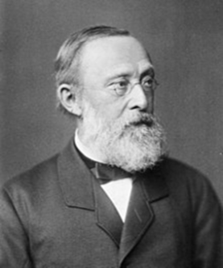
Virchow, the exponent of „cell pathology” also persistently attacked his doctrines. In his lecture of 1858, he still insisted that the cause of puerperal fever disease are the atmosheric and suppurative disease with simultaneous occurrence of milk secretion disorder, neural alteration and stress.
Many obstetrics claimed that their experiences do not support Semmelweis’ observations.
Others emphisized that they are too simple to be true!
Hugo Fogel, Virchow, 1861

Slide 43
Deification

Slide 44
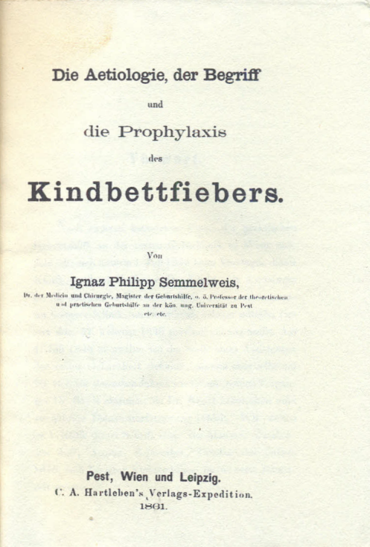
Die Ätiologie, der Begriff und die Prophylaxis des Kindbettfiebers von Ignaz Philipp Semmelweis. Pesth-Wien-Leipzig, C.A. Hartleben Verlag, 1861 (Ignaz PhilipSemmelweis, The Concept, Aetiology and Prevention of Puerperal Fever, Pesth-Vienna-Leipzig, C.A. Hartleben Publisher, 1861.)
Also published in English in the United States in 1941. The renown historiographer Sticker wrote the following when reviewing the book: „the truth of its content and the clarity of its presentation put it among the best publications in medical literature, it should be considered in line with Robert Koch’s book „Study of the Aetiology of Wound Infections” and Pasteur’s articles on fowl cholera.

Slide 45
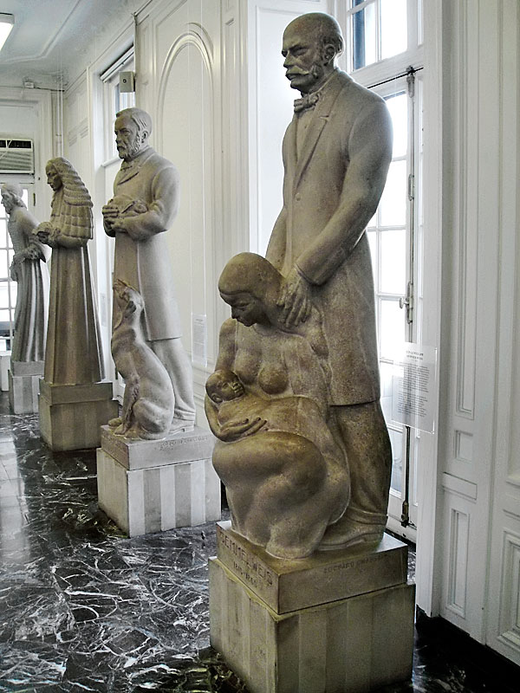
The 12 most innovative persons in health management
The life-size statue of Semmelweis
with its 11 neighbours
in the Hall of Immortals
International Museum of Surgical Science
Chicago

Slide 46
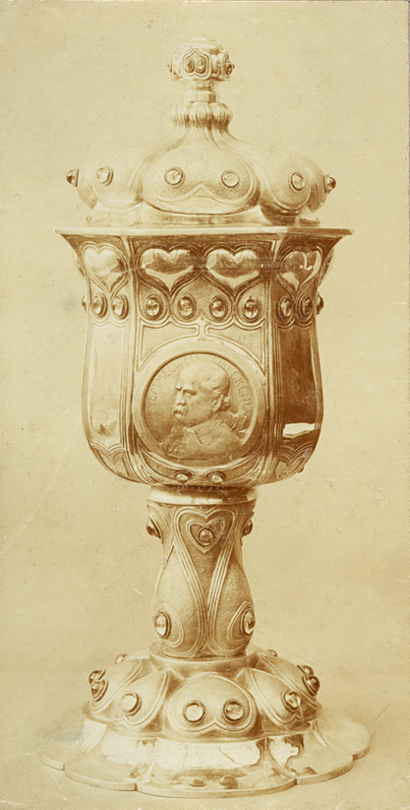
„SEMMELWEIS – presented at the feast of the Semmelweis-Goblet at the Budapest Medical Casino on 30th January, 1925 Grósz Emil Dr. teacher of university, Royal Hungarian University Press, Budapest”.
Ecseri Flea Market, 2013
Semmelweis memorial speeches 1907-1941, Company of Hungarian Medical Editors, Budapest, 1947.
Picture of Semmelweis-chalice
(Hungarian Medical Casino, 1906)

Slide 47
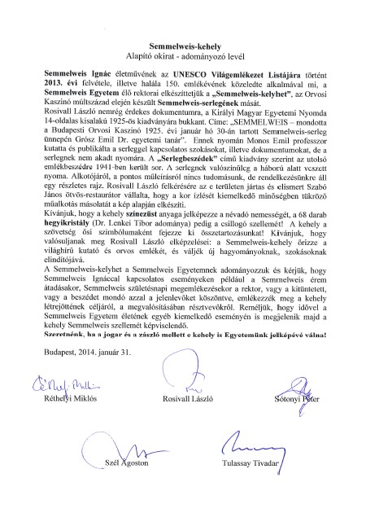
Semmelweis-chalice
Certificate of incorporation
founding letter
2014

Slide 48
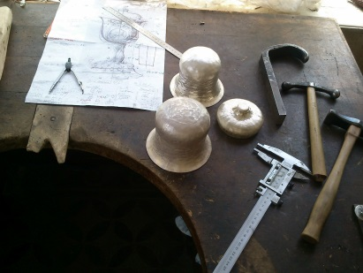
Traditional technique has been applied by the young master,
jr. Janos Szabo

Slide 49
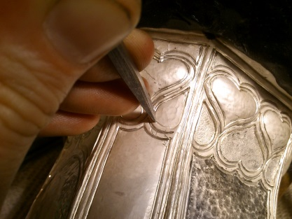
There was 9 month between the conception of idea and presentation of Semmelweis-chalice
at the Opening Ceremony of Semmelweis University, 2014.

Slide 50
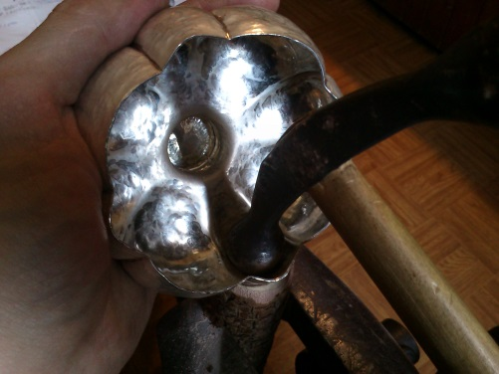
Chalice: 30 cm, cuppa diameter: 13 cm,
1355 g sterling silver, 32 rhinestones, 40 amethyst stones

Slide 51
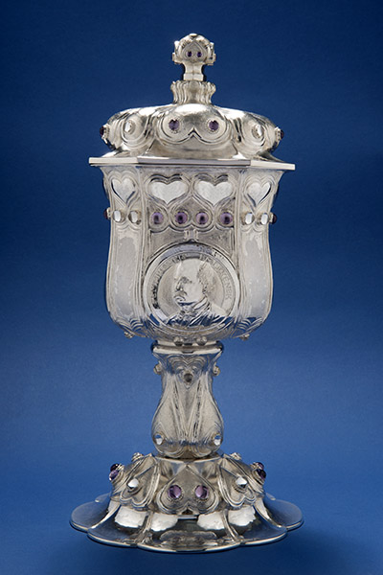
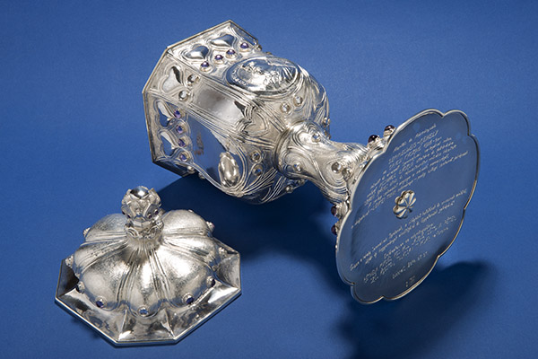
Semmelweis-chalice
This is a copy of lost Semmelweis goblet (1906) Medical Casino made by jr Szabó according the order of L. Rosivall.
„May this Chalice keep the memory of the world famous researcher and physician, Ignác Semmelweis, may it become the starter of new traditions and symbol of our University! ” Donators: the living rectors of Semmelweis University

Slide 52
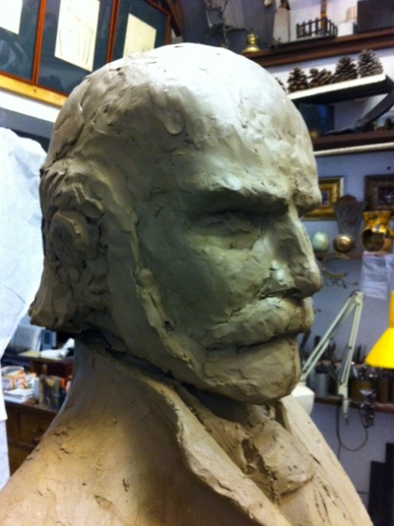
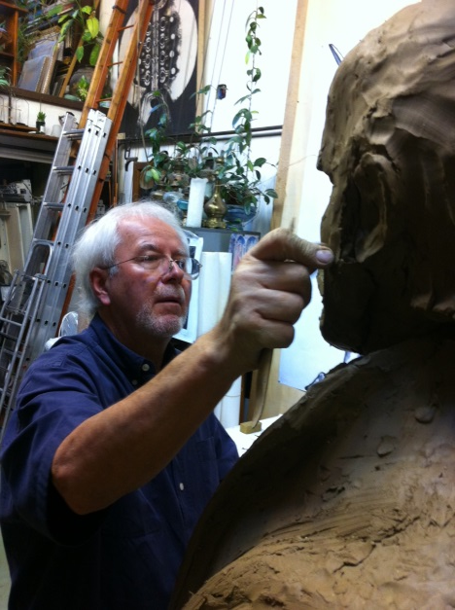
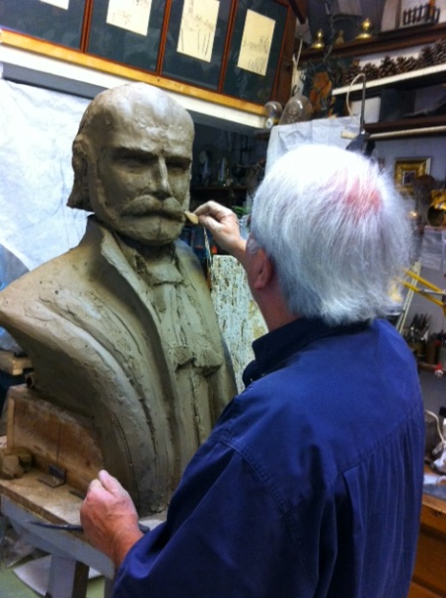
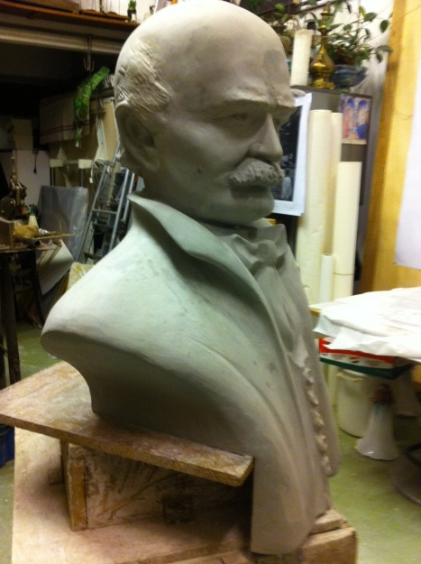
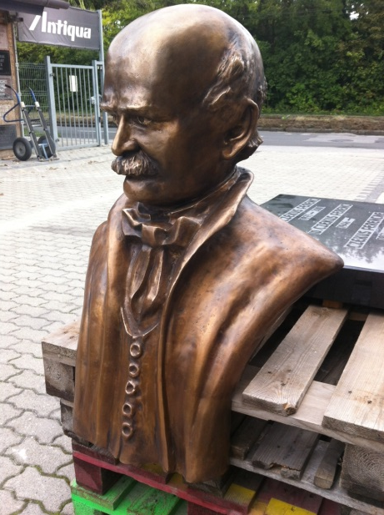
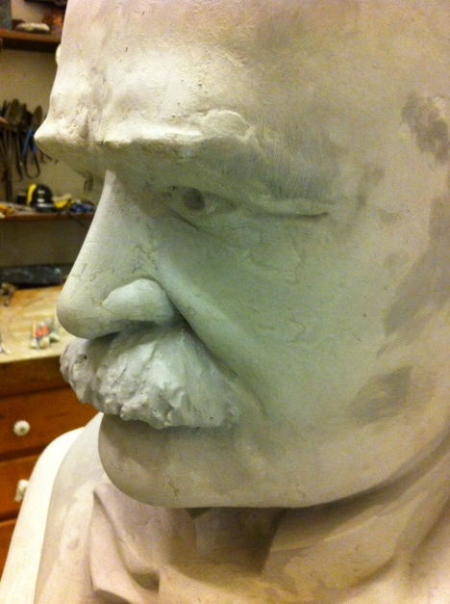
Preparation of Semmelweis statue ordered by Tehran University of Medical Sciences,
Semmelweis University and Avicenna International College
Clay and plaster model and cast in bronze

Slide 53
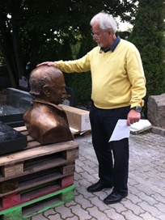
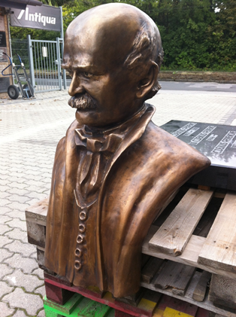
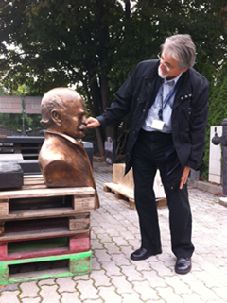
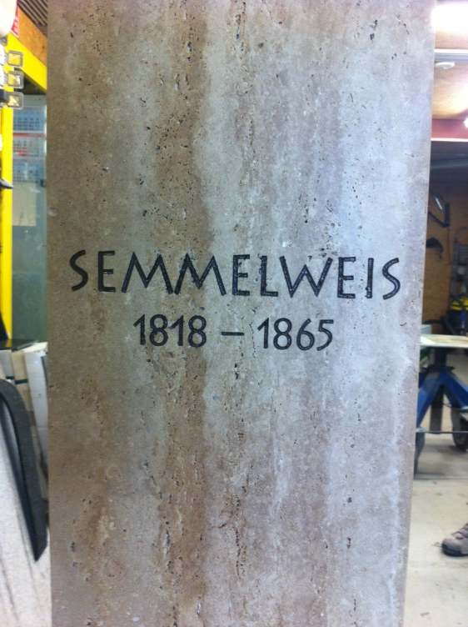
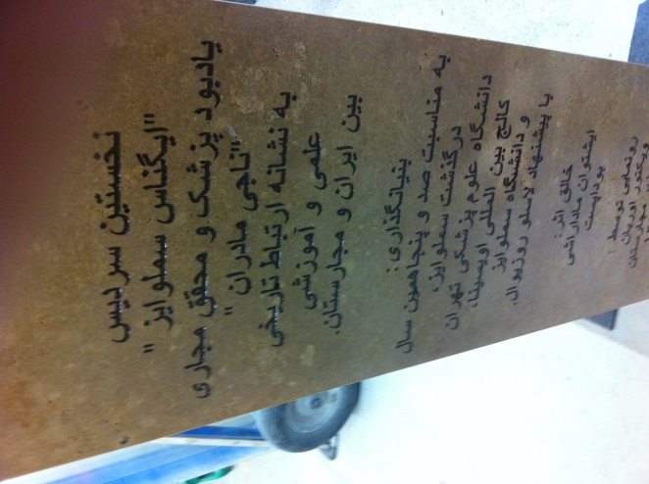
Semmelweis bronze statue is about to go to Tehran

Slide 54
Semmelweis has started moving to East in bronze

Slide 55
Teheráni Orvostudományi Egyetem kertjében
2016
2015

Slide 56
Wreathing at birthday of Semmelweis,1st of July, 2016

Slide 57
A new term in Anglo-Saxon countries
The „Semmelweis-reflex”
Professionals, or society, almost reflexively reject significant new facts and discoveries without even examining them or giving an explanation.
This phenomenon is quite frequent also today!

Slide 58
„My teachings are,
for the teachers of medical science to disseminate, for the practitioners and the nurses to follow, from the small village barber to the last country newborn, to scare off the boogeyman of the maternity house, to rescue the wife for her husband, the mother for her child.”
Semmelweis, 1861

Slide 59
Comemoration of Anniversary of the 200th
Birthday of Semmelweis

Slide 60
Statue of „Vizitation” at Gynecology Department of Semmelweis University
„My education is to save the wife for the housband and the mother for the baby”
Tanításom arra való, hogy megmentsem a feleséget a férfi,az anyát a gyermek számára.”

Slide 61
Celebration at Foreign Coutries
- Hungarian Institutes: Vienna, Berlin, Bucarest, Delhi, Helsinki, Istanbul,
Cairo, London, Moskva, New York, Páris, Bejing, Prague, Rome,
Stuttgart, Sofia, Tallinn, Warso, Zagrabe etc.
- Embassies:New-Zealand, Japan, Iran, Australia etc.
- Others: erecting statues/bronse bust
Japan: Prof. Dr. Kyoshi Kurokawa, erection of Semmelweis statue
Macedónia: Momir Palenkovics, Goce Spasovski scientific meeting-
Oxrord: Prof. Dr. Peter Somogyi, Oxford,
Maribor: Prof. Dr. Ludvik Toplak
USA, LA, Harvard U.:: Dr. Jonathan Jakus, Réka Peti-Peterdi, statues
Carol University, Prague, Prof. Tomas Zima rector, Prof. Dr. Tesar Vladimir,
Timisaora: Prof. Dr. Adalbert Schiller,
Berlin: Charite, Prof. Dr. Joseph Makovotzky
Krakow: Jagello U. Rector, B. Nowak etc
- Semmelweis, Iranian-Hungarian bilateral meeting Prof. Dr. Ali Jafarian, rector

Slide 62
Letter of President of Hungary to Laszlo Rosivall with the information of acceptance the invition to be the patron of Semmelweis Memorial Year in 2018.

Slide 63
Memorial Book in Hungarian and English
Exhibitions
Hungarian Post: commemorative stamps
National Bank: Coins
Scientific Meetings
University Courses on Semmelweis in Hungarian and English, etc
Sport Events
Studies on asepsis condions in hospitals

Slide 64
Semmelweis has arrrived to
the National Theater
after 50 years
Performance of „Semmelweis„ drama (1968) written by Jens Bjørneboe (1920-1976), reknown Norwegian writer at 9 of October, 2016 was the opener of the Memorial Year

Slide 65
The Movement of Clean Hands
has been launched in Hungary,
Successively in Region and the World

Slide 66
„Nem hal meg az, ki milliókra költi Dús élte kincsét, ámbár napja múl; Hanem lerázván, ami benne földi, Egy éltető eszmévé fínomul, Mely fennmarad s nőttön nő tiszta fénye, Amint időben, térben távozik;”
Arany János

