Slide 1
He who we are proud of
The work and living presence of Ignaz Semmelweis
Bicentenary birthday
2017/2018 Spring Semester
The memory of Semmelweis in the art of theatre
Prof. Dr. Laszlo Rosivall and Alexander Nardocci
Institute of Pathophysiology
PhD School of Basic and Translational Medical Sciences
International Nephrology Research and Training Center
Semmelweis University
Tehran University of Medical Sciences

Slide 2
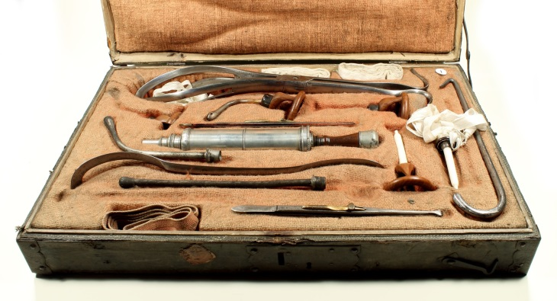
Ignac Semmelweis
Doctor of Medical Sciences and Surgery, Master of Obstetrics at the Pest Royal Hungarian University of Sciences,
Professor of Practical Obstetrics
„Savior of mothers and newborns,
who overcame the disease
but could not convince the people”!
Obstetrician surgical set from the time of Semmelweis

Slide 3
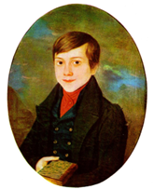
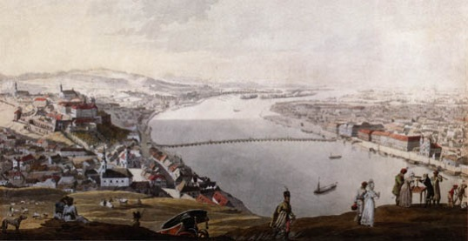
What a simple and successful life
Curriculum vitae
Birth: July 1st ,1818 in Buda to a German speaking family, fifth child of 10.
Name: family names registered in 7 different forms, there are no „w”,
„mm” among them.
Studies: High School, in Castle of Buda, eminent even in Hungarian
University (Vienna): 1837 law student
1838 medical student
1844 MD.
1844 obstetrician
1845 surgeon
Work: Obstetrics Department, Vienna University 1844-1850
Discovery 1847 (29 years old)
Head of Obstetrics, Rókus Hospital, Pest 1851-1855
Professor of Obstetrics University of Pest 1855-1865
Death: 1865, Vienna
Buda, 1818

Slide 4
Pioneer of Epidemiology Research
Animal experimental model of puerperal fever
Pioneer of Clinical Pathophysiology
Semmelweis managed to beat the disease,
but did not succeed
in convincing the age!
Semmelweis Reflex

Slide 5
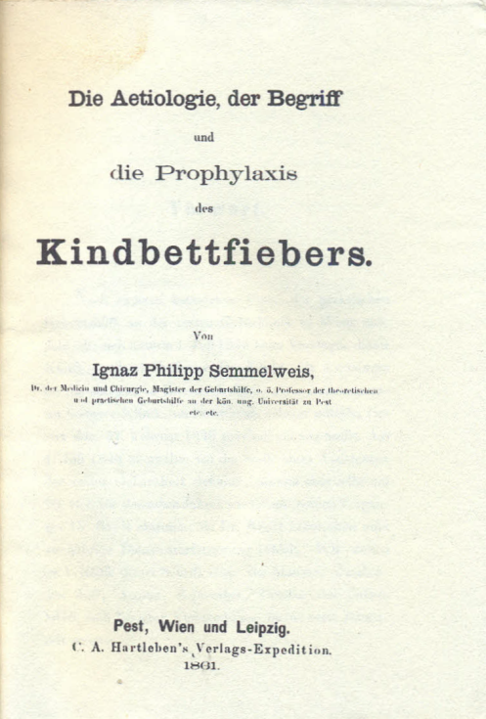
Die Ätiologie, der Begriff und die Prophylaxis des Kindbettfiebers von Ignaz Philipp Semmelweis. Pesth-Wien-Leipzig, C.A. Hartleben Verlag, 1861 (Ignaz Philip Semmelweis, The Concept, Aetiology and Prevention of Puerperal Fever, Pesth-Vienna-Leipzig, C.A. Hartleben Publisher, 1861.)
Also published in English in the United States in 1941. The renown historiographer Sticker wrote the following when reviewing the book: „the truth of its content and the clarity of its presentation put it among the best publications in medical literature, it should be considered in line with Robert Koch’s book „Study of the Aetiology of Wound Infections” and Pasteur’s articles on fowl cholera.

Slide 6
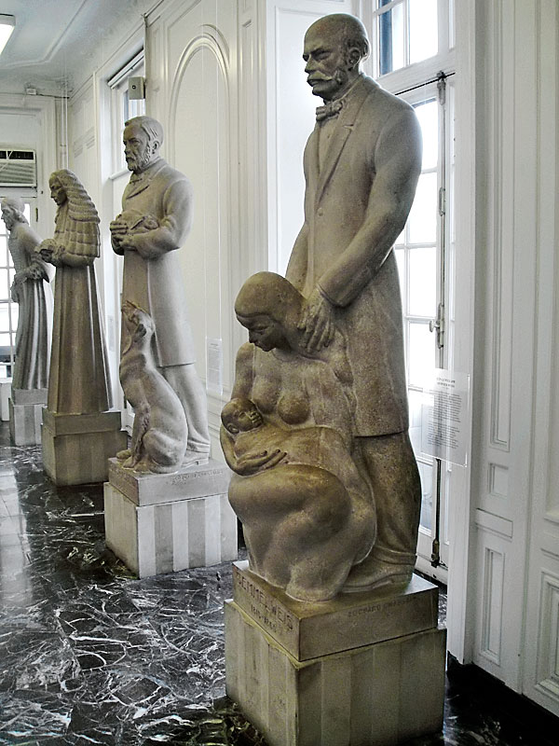
The 12 most innovative persons in health management
The life-size statue of Semmelweis
with its 11 neighbours
in the Hall of Immortals
International Museum of Surgical Science
Chicago

Slide 7
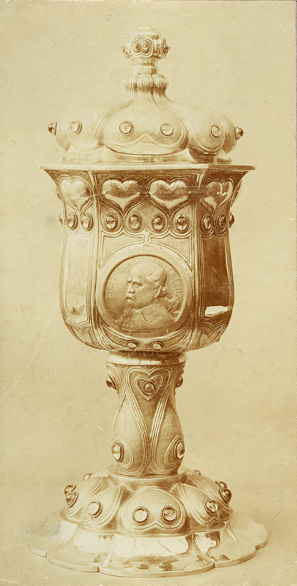
„SEMMELWEIS – presented at the feast of the Semmelweis-Goblet at the Budapest Medical Casino on 30th January, 1925 Grósz Emil Dr. teacher of university, Royal Hungarian University Press, Budapest”.
Ecseri Flea Market, 2013
Semmelweis memorial speeches 1907-1941, Company of Hungarian Medical Editors, Budapest, 1947.
Picture of Semmelweis-chalice
(Hungarian Medical Casino, 1906)

Slide 8
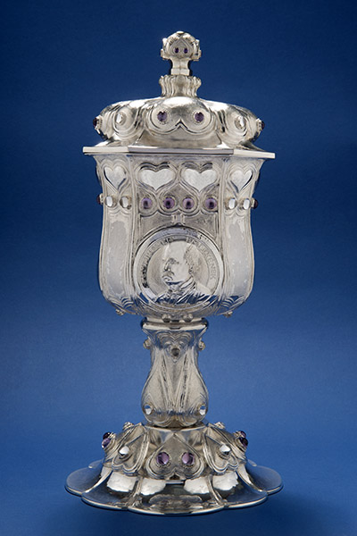
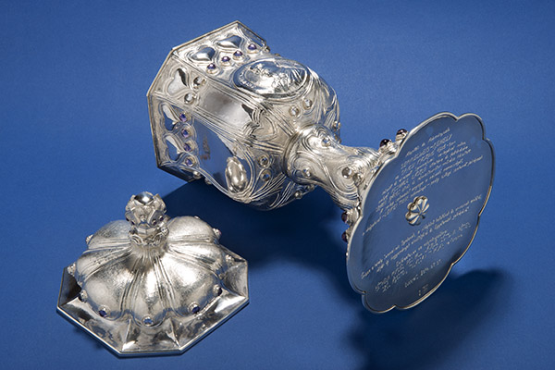
Semmelweis-chalice
This is a copy of lost Semmelweis goblet (1906) Medical Casino made by jr Szabó according the order of L. Rosivall.
„May this Chalice keep the memory of the world famous researcher and physician, Ignác Semmelweis, may it become the starter of new traditions and symbol of our University! ” Donators: the living rectors of Semmelweis University

Slide 9
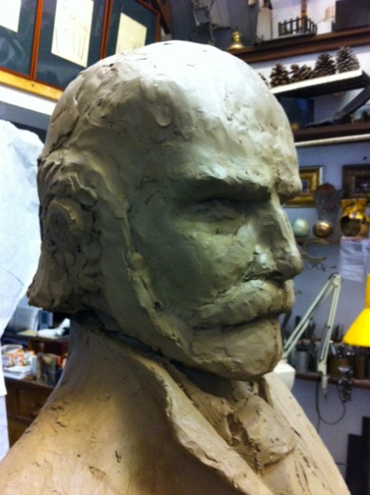
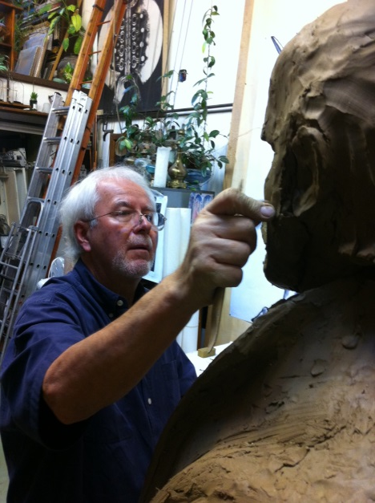
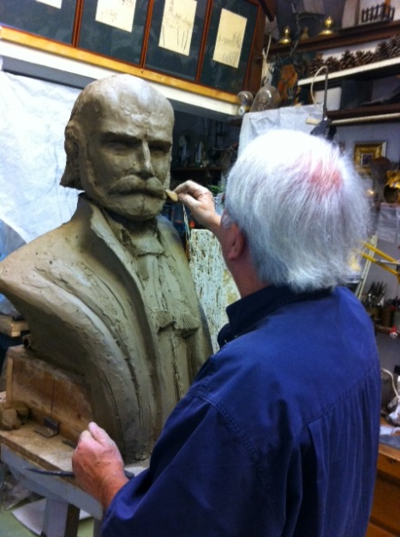
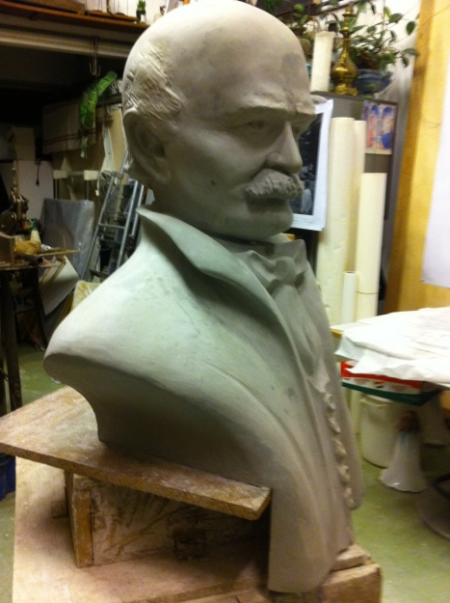
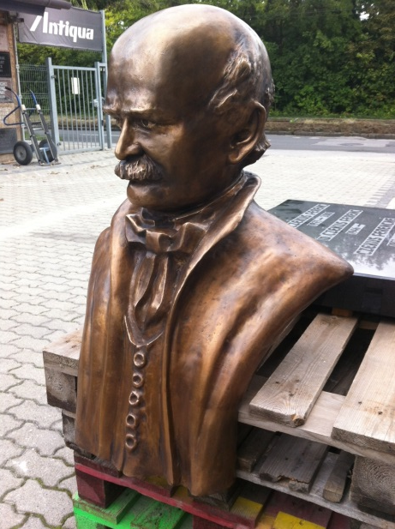
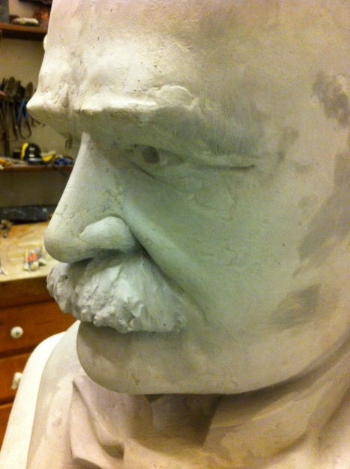
Preparation of Semmelweis statue ordered by Tehran University of Medical Sciences,
Semmelweis University and Avicenna International College
Clay and plaster model and cast in bronze

Slide 10
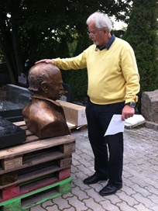
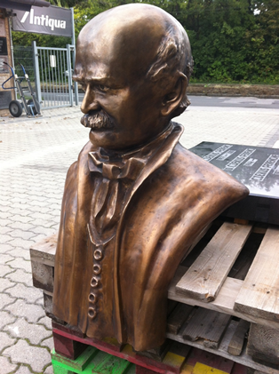
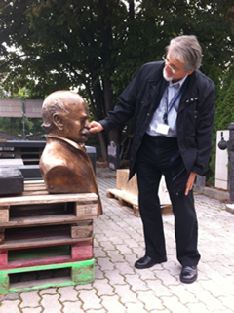
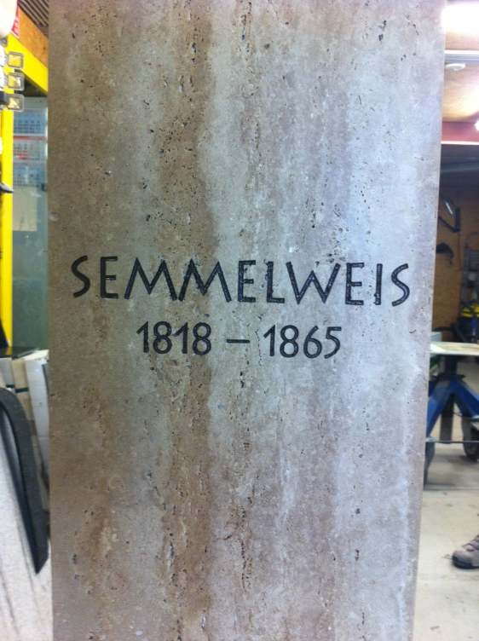
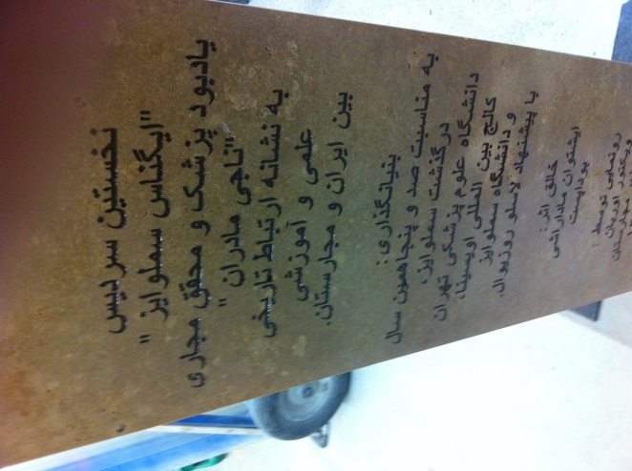
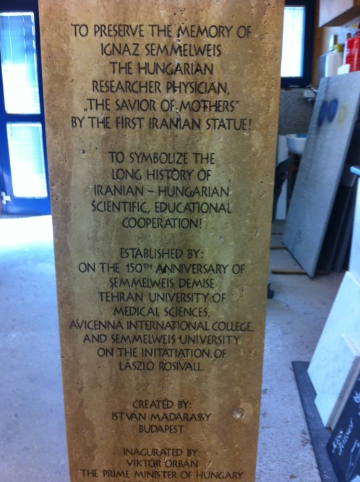
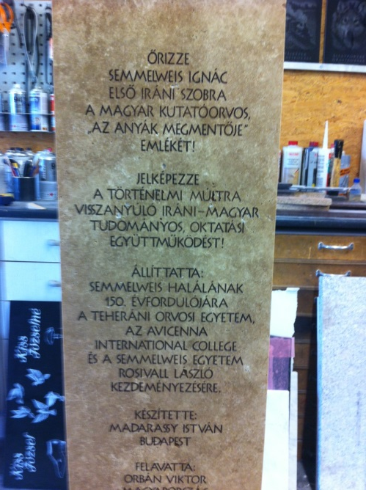
Semmelweis bronze statue is about to go to Tehran

Slide 11
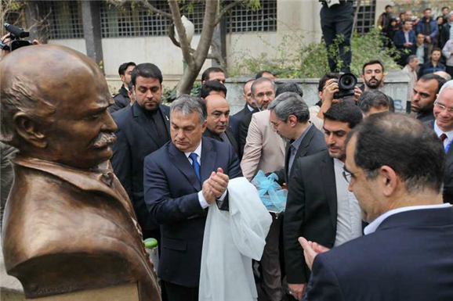
Semmelweis has started moving to East in bronze

Slide 12
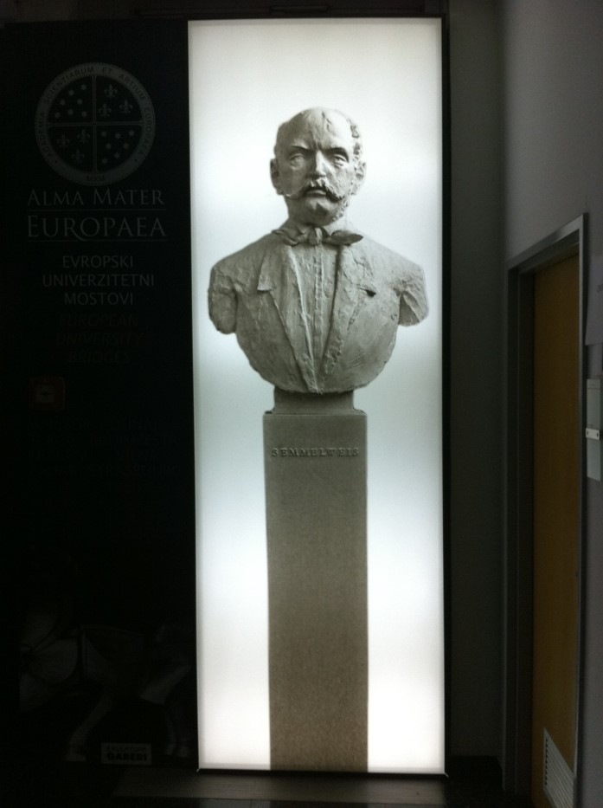
Semmelweis in Maribor
Made by Ivan Paulikovics

Slide 13
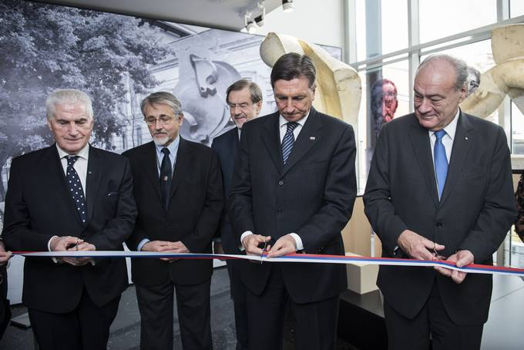
Opening of the Exhibition
From left to right: rector of Alma Mater Europea, Ludvic Toplak, past Rector of Semmelweis University, Rosivall László, first President of independent Slovenia, Lojze Peterle, President of Slovenian Republic, Borut Pahor and the President of European Academy of Arts and Sciencies

Slide 14
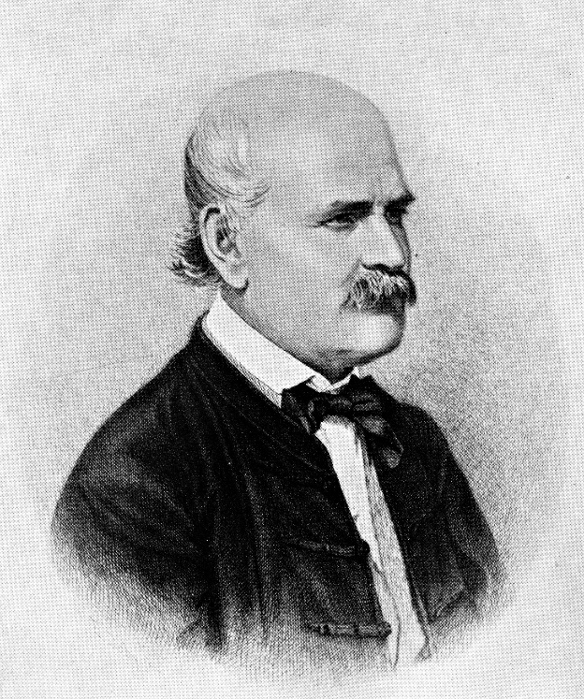
„My teachings are,
for the teachers of medical science to disseminate, for the practitioners and the nurses to follow, from the small village barber to the last country newborn, to scare off the boogeyman of the maternity house, to rescue the wife for her husband, the mother for her child.”
Semmelweis, 1861

Slide 15
A successful Norwegian stage-play
to the memory of Ignaz Semmelweis:
Jens Bjørneboe – Semmelweis
(story of my incidental „discovery”)
Prof. emer. Dr. Emil Monos,
Institute of Clinical Experimental Research
Semmelweis University, Budapest
March 19, 2018. 16:30-17:15

Slide 16
“It was an honourable task and great experience for me that, as Vice Rector for Education, I could represent the leadership of Semmelweis University at some conferences of CRE (Association of European Universities), the legal predecessor of EUA (European University Association). These significant international meetings, besides the carefully organized collective professional programmes, provided excellent opportunities for personal meetings and conversations with leading personalities of various European universities. It was like this at the 52nd CRE Conference (28-29 October 1999, Valencia, Spain), too. I happened to take a seat near to professor Tove Bull, chairwoman of the Norwegian Rectors’ Conference, Rector of Tromso University. She was also one of the 180 participants. During the break we started to talk.

Slide 17
To my great surprise and delight, though not working in the field of medicine or biology (she is professor of Scandinavian linguistics), Dr. Tove Bull had already heard of Semmelweis and she took a keen interest to my exposition. Even the day after the Conference, during an exciting group excursion to the Castle of Xativa, we returned to the Semmelweis topic again and again.
A few months later I received a surprising parcel from Norway: a present from Rector Tove Bull. There was an English edition of Jens Bjørneboe’s drama written in Norwegian with the title „Semmelweis” in the parcel! It was translated by Joe Martin, a writer, translator of literary works and theatre-manager (Washington, D.C.). He wrote a thorough introductory essay, as well. On the coloured book cover there was a reproduction of the expressionistic painting titled “Dead mother” by the Austrian Egon Schiele made in 1910 (Figure 3).

Slide 18
Semmelweis has arrrived to
the National Theater
after 50 years
Performance of „Semmelweis„ drama (1968) written by Jens Bjørneboe (1920-1976), reknown Norwegian writer at 9 of October, 2016 was the opener of the Memorial Year
Prof. Monos’ story on the
Semmelweis drama

Slide 19
Figure 4. One of the Norwegian editions of Bjørneboe’s drama „Semmelweis” with the author’s portrait on the cover page.

Slide 20
Bjørneboe (1920, Kristiansand, Norway -1976, Veierland, Nøtterøy, Norway) is regarded as one of the most controversial Norwegian writers of his time. History of literature considers him a writer of novels, a poet, a dramatist, a journalist and an essayist. His father was a ship-owner and a consul. The young Jens sharply reacted to the provincialism of his hometown, he was expelled from a number of schools. When he was 16 he became a sailor and returned home only 3 years later for his father’s funeral. He spent the years of German occupation in Sweden. Bjørneboe started to write in the 1950-ies. He turned to playwriting in the 1960-ies which he considered a suitable literary form to put on the stage his literary sieges against a hierarchic society in the form of an aggressive extroverted theatre. His works created several scandals and provoked court cases.

Slide 21
Like most of his heroes he described himself as a person unable to adjust to his surroundings and insisting on his own deviances. His famous novel trilogy („Frihetens oyeblikk” – Moment of Freedom, „Kruttarnet” – Powder magazine, „Sillheten” – Silence) was written between 1966 and 1973 and collected as “The history of bestiality”. According to his idea he wanted to cry out to the world through his novels and dramas the uncompromising demand for justice of authoritative individuals against the horrors of history. This is confirmed by his dramas like “Semmelweis”, “Congratulation” or “Amputation”. He is considered the most innovative playwright of Norway. He is the dramatist of standoffishness and alienation whose art was perhaps most influenced by the dramatist Bertold Brecht (1898-1956).
Bjørneboe wrote his drama „Semmelweis” in 1968-69. Very few people know – even today - that the world première was held in Finland, in the Swedish Abo Svenska Theatre of Turku in September 1969 (Figure 5.).

Slide 22
Figure 5. The facade of Abo Svenska Theatre in Turku.
Lars Svedberg the newly appointed manager of the theatre played the role of Semmelweis (Figure 6.).

Slide 23
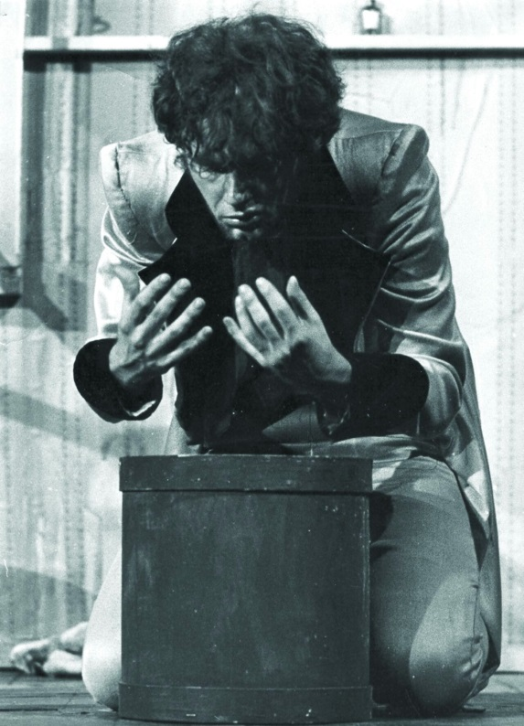
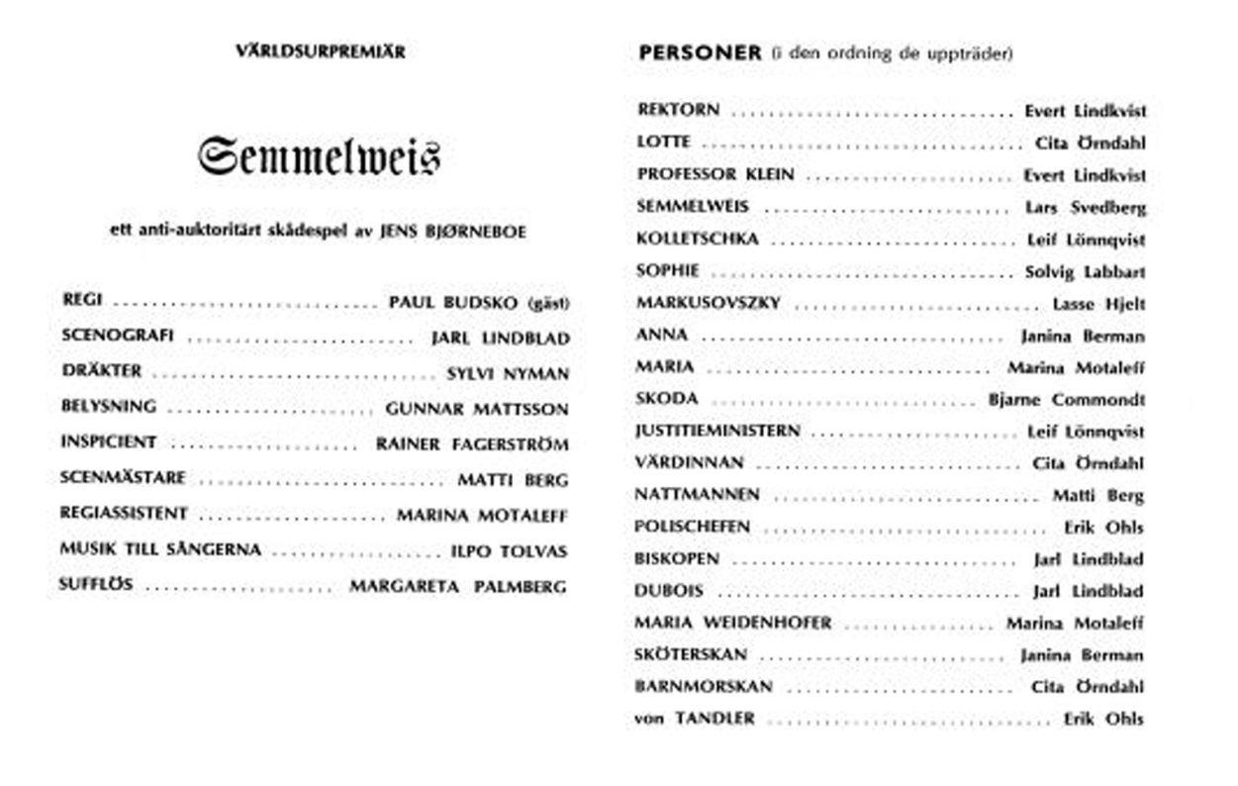
Figure 6. Cast of the play „Semmelweis” on the programme at the Finland première (September 1969) and Lars Svedberg playing the leading role at this première of “Semmelweis”.

Slide 24
At the same time this was also the theatre-manager’s début. Soon after this, in the same year, on 19th November the drama was also performed in Norway, in the National Theatre of Oslo (generally, this is regarded as the world premiere). In a short time the play completed a full tour round the Baltic Sea: it was performed in Sweden and Denmark, too. Critiques, especially in Norway and Denmark, were very enthusiastic, also about the leading role of Joachim Calmeyer. This role was ranked immediately behind that of Peer Gynt (the most famous drama of Henrik Ibsen).
Following the Baltic countries Jens Bjørneboe’s „Semmelweis” was also performed in several theatres in the USA: in 1977 in Buffalo (NY) in the „Studio Arena Theatre” (with L.J. Stadlen, K. Bates, and K. Hunter in the main roles), in 1978 in Kennedy Centre, Washington, D.C (with C. Blakeley in the leading role), and in 1981 in Hartman Theatre of Stamford (Connecticut).

Slide 25
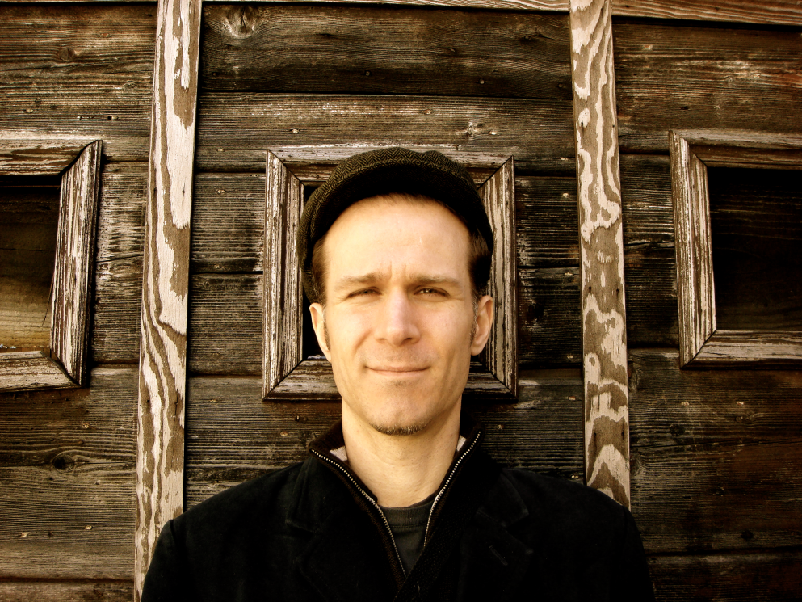
Ray Lustig , music composer, New York
Semmelweis opera, 2017, September 11. New York
Awards include the Charles Ives Fellowship from the American Academy of Arts and Letters, ASCAP’s Rudolf Nissim Prize for his orchestral work UNSTUCK, and the Aaron Copland Award from Copland House.
https://soundcloud.com/ray-lustig/semmelweis-live-at-the-nac-medley-of-clips?in=ray-lustig/sets/sample-demos-from-semmelweis

