Slide 1
The ouvre of Semmelweis in the Memory of the World Register - UNESCO
Dr. Miklós Réthelyi

Slide 2
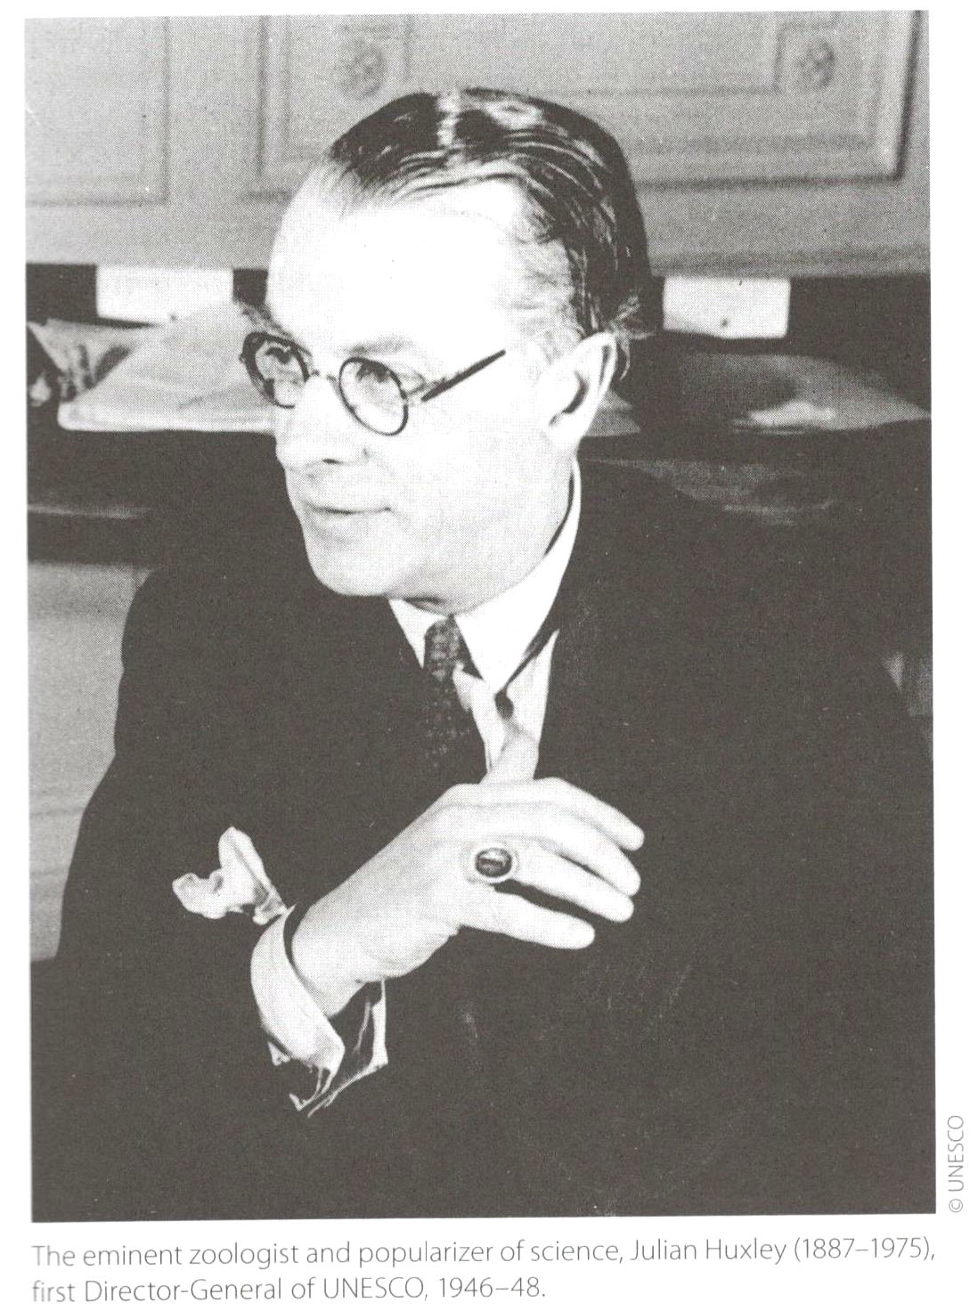
The United Nations Educational, Scientific and Cultural Organization (UNESCO) is a specialized agency of the United Nations based in Paris.
UNESCO is known as the "intellectual" agency of the United Nations. At a time when the world is looking for new ways to build peace and sustainable development, people must rely on the power of intelligence to innovate, expand their horizons and sustain the hope of a new humanism. UNESCO exists to bring this creative intelligence to life; for it is in the minds of men and women that the defences of peace and the conditions for sustainable development must be built. (Introducing UNESCO)
The eminent zoologist and popularizer of science, Julian Huxley (1887-1975), first Director General of UNESCO, 1946-48

Slide 3
The Memory of the World is
the documented, collective memory of the peoples of the world
– their documentary heritage –
which in turn represents a large proportion of the world’s cultural heritage.
It charts the evolution of thought, discovery and
achievement of human society.
It is the legacy of the past
to the world community of the present and the future.

Slide 4
Program Background
UNESCO established the Memory of the World Program in 1992.
Impetus came originally from
a growing awareness of the parlous state of
preservation of and access
to documentary heritage in various parts of the world.
War and social upheaval, as well as severe lack of resources,
have worsened problems which have existed for centuries.
Significant collections worldwide have suffered a variety of fates. Looting and dispersal, illegal trading, destruction, inadequate housing and funding have all played a part.
Much is vanished forever; much is endangered.
Happily, missing documentary heritage is sometimes rediscovered.

Slide 5
The Memory of the World Program has three main objectives:
(a) To facilitate preservation …. of the world’s documentary heritage.
(b) To assist universal access to documentary heritage.
(c) To increase awareness worldwide of the existence and significance of
documentary heritage.
The Memory of the World Register the most publicly visible aspect of the Program – was founded on the 1995 General Guidelines and has grown through accessions approved by successive International Advisory Committee (IAC) meetings.
The vision of the Memory of the World Program is that the world’s documentary heritage belongs to all, should be fully preserved and protected for all and, with due recognition of cultural mores and practicalities, should be permanently accessible to all without hindrance.
The mission of the Memory of the World Program is to increase awareness
and protection of the world’s documentary heritage, and achieve its universal and permanent accessibility.

Slide 6
The registers of the Memory of the World
The Memory of the World Program will maintain public registers of documentary heritage.
There are three types of register: international, regional and national. All
registers contain material of world significance and a given item may appear in more than one register.
When considering documentary heritage for inclusion in the Register the item will be first assessed against the threshold test of authenticity.
Second, the IAC must be satisfied that the nominated item is of world
significance. That is, it must be: unique and irreplaceable,
Thirdly, world significance must be demonstrated in meeting one or more of
the criteria set out below.
Criterion 1 – Time Criterion 4 – Subject and theme
Criterion 2 – Place Criterion 5 – Form and style
Criterion 3 – People
Finally, the following matters will also be taken into account:
Rarity; Integrity; Threat; Management plan

Slide 7
The Hungarian elements
of the World memory register

Slide 8
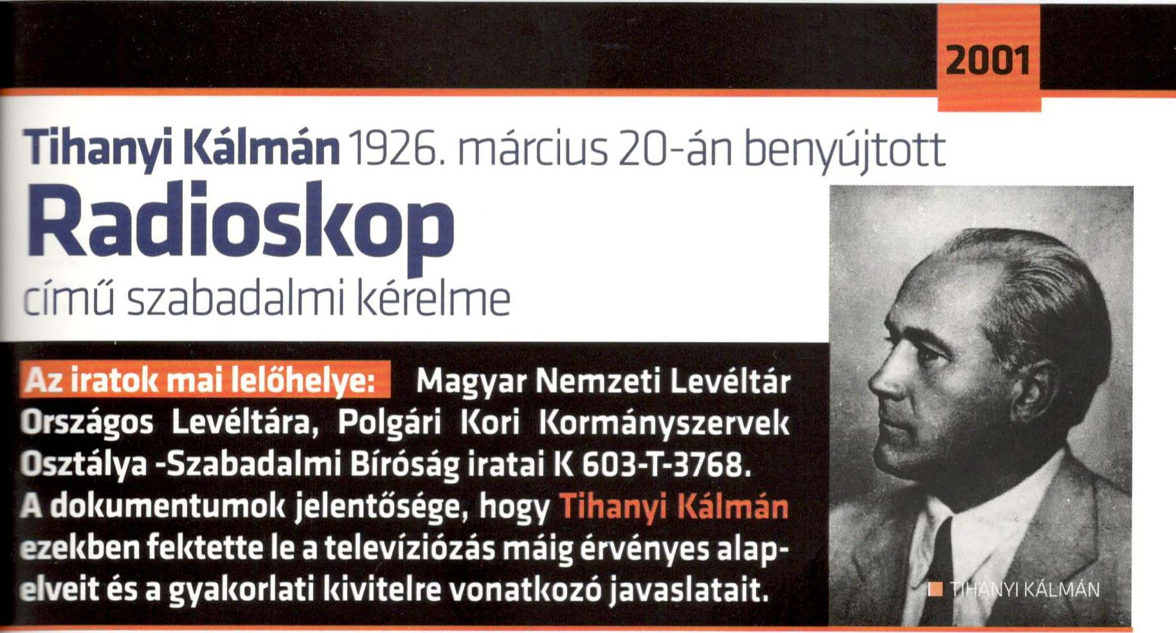
Kalman Tihanyi’s 1926 Patent Application "Radioskop"
The television system, which in the wake of the publication of Kalman Tihanyi’s French and British patents of 1928 priority gave new direction to television development, is recognized by historiography as one of the great inventions of the 20th century. This invention, the last of the three "evolutionary leaps" discernible within the developmental history of television, made possible its technical realization and industrial mass-production. .

Slide 9
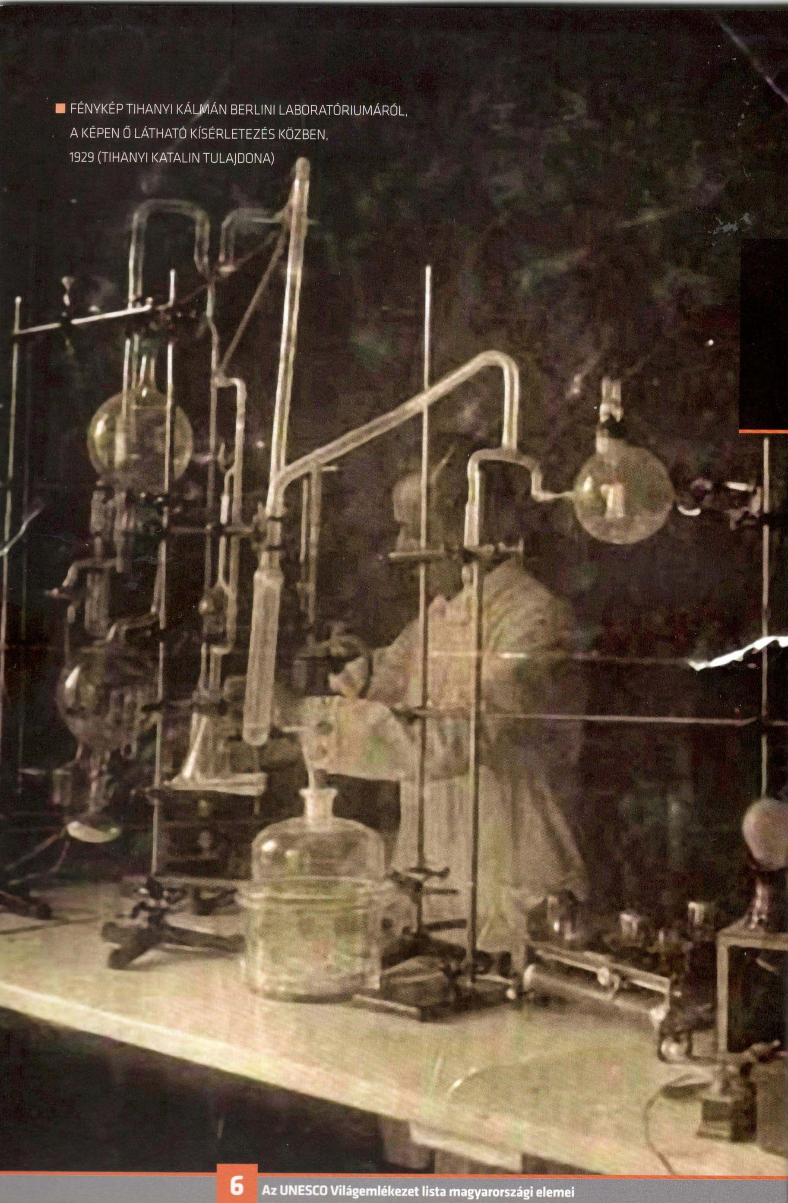
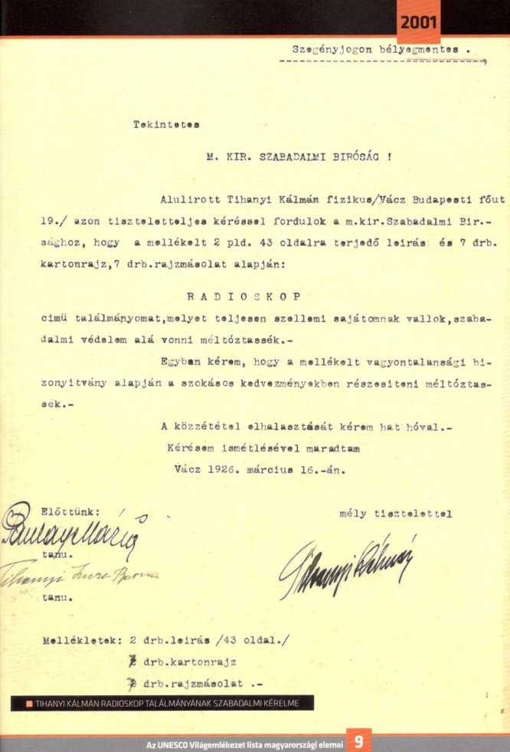
Kálmán Tihanyi in his lab, Berlin, 1929
Letter for patent application, 1926

Slide 10
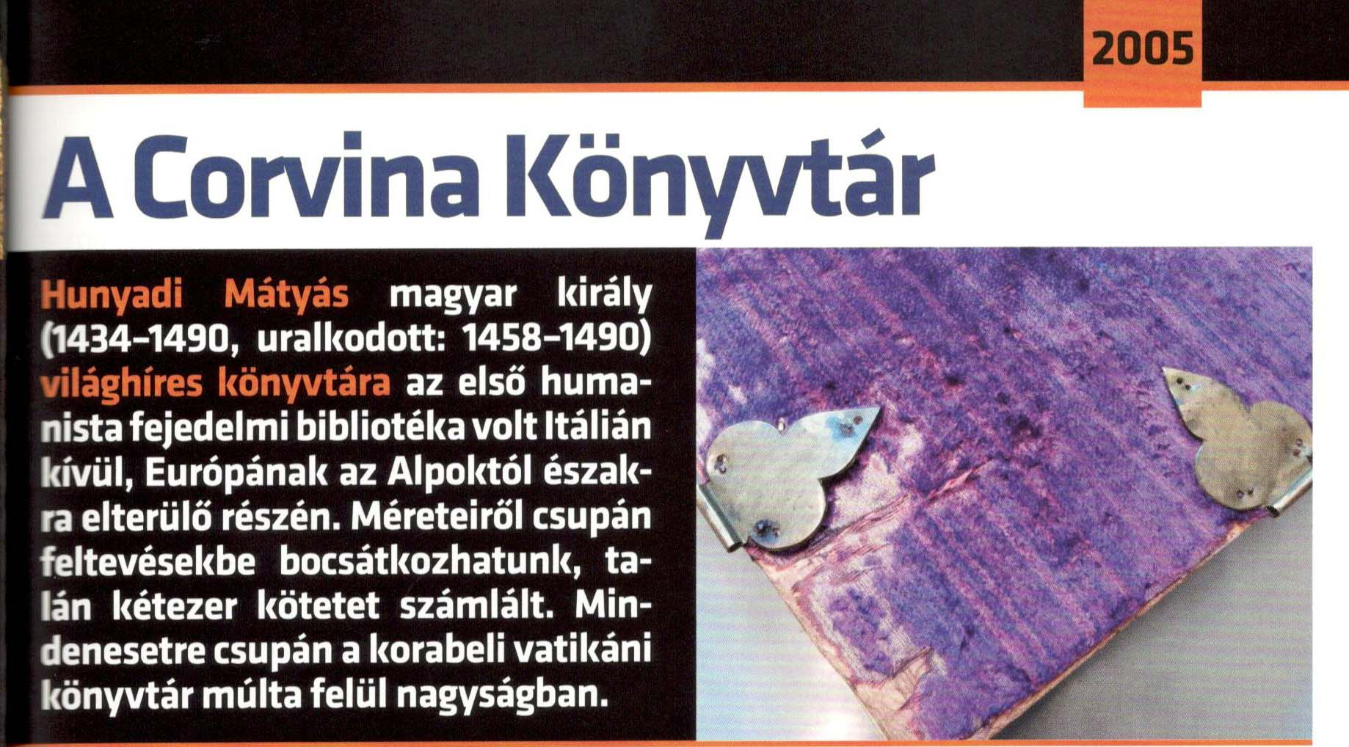
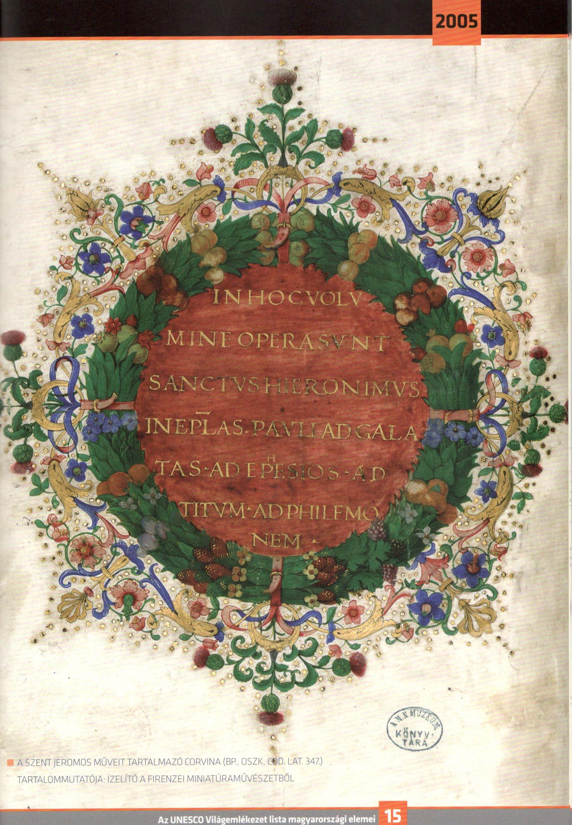
The Bibliotheca Corviniana Collection
Documentary heritage submitted by Austria, Belgium, France, Germany, Hungary and Italy and recommended for inclusion in the Memory of the World Register in 2005.
The Bibliotheca Corviniana was the second greatest collection of books in Europe in the Renaissance period, after that of the Vatican. It contained works written for King Mathias (1458-1490) and copies of the most important documents known at this time. It represented the literary production and reflected the state of knowledge and arts of the Renaissance. The collection covered philosophy, theology, history, law, literature, geography, natural sciences, medicine, architecture, etc..
Hieronymus: Commentarii in epistolas S. Pauli cca. 1488, Firenze,

Slide 11
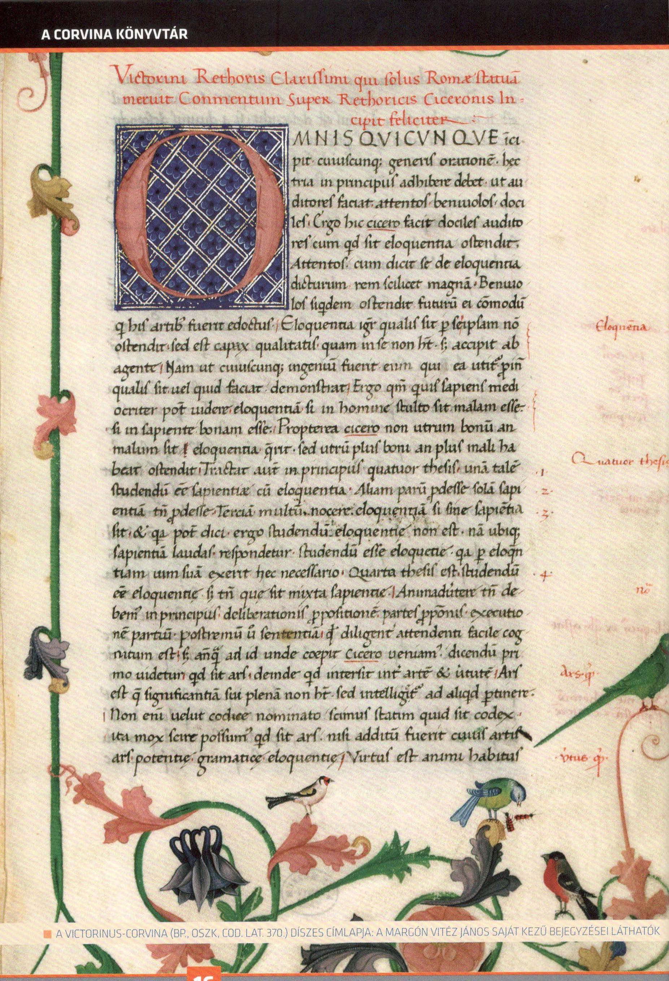
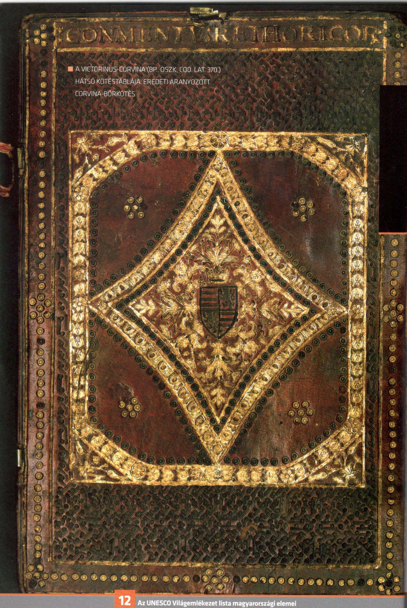
Today 216 Corvinas are known to exist all over the world. Only 53 items are kept in Hungary. The Austrian National Library possesses 39 volumes, different Italian libraries own 49 items and the rest is in French (7), German (8), English, Turk and USA collections.
Victorinus Corvina, back cover
Victorinus Corvina, title page

Slide 12
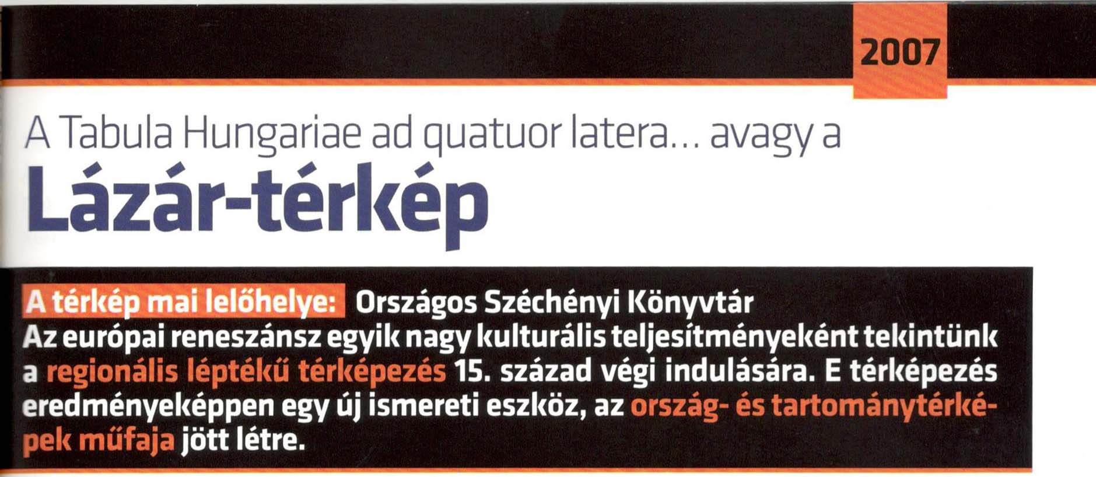
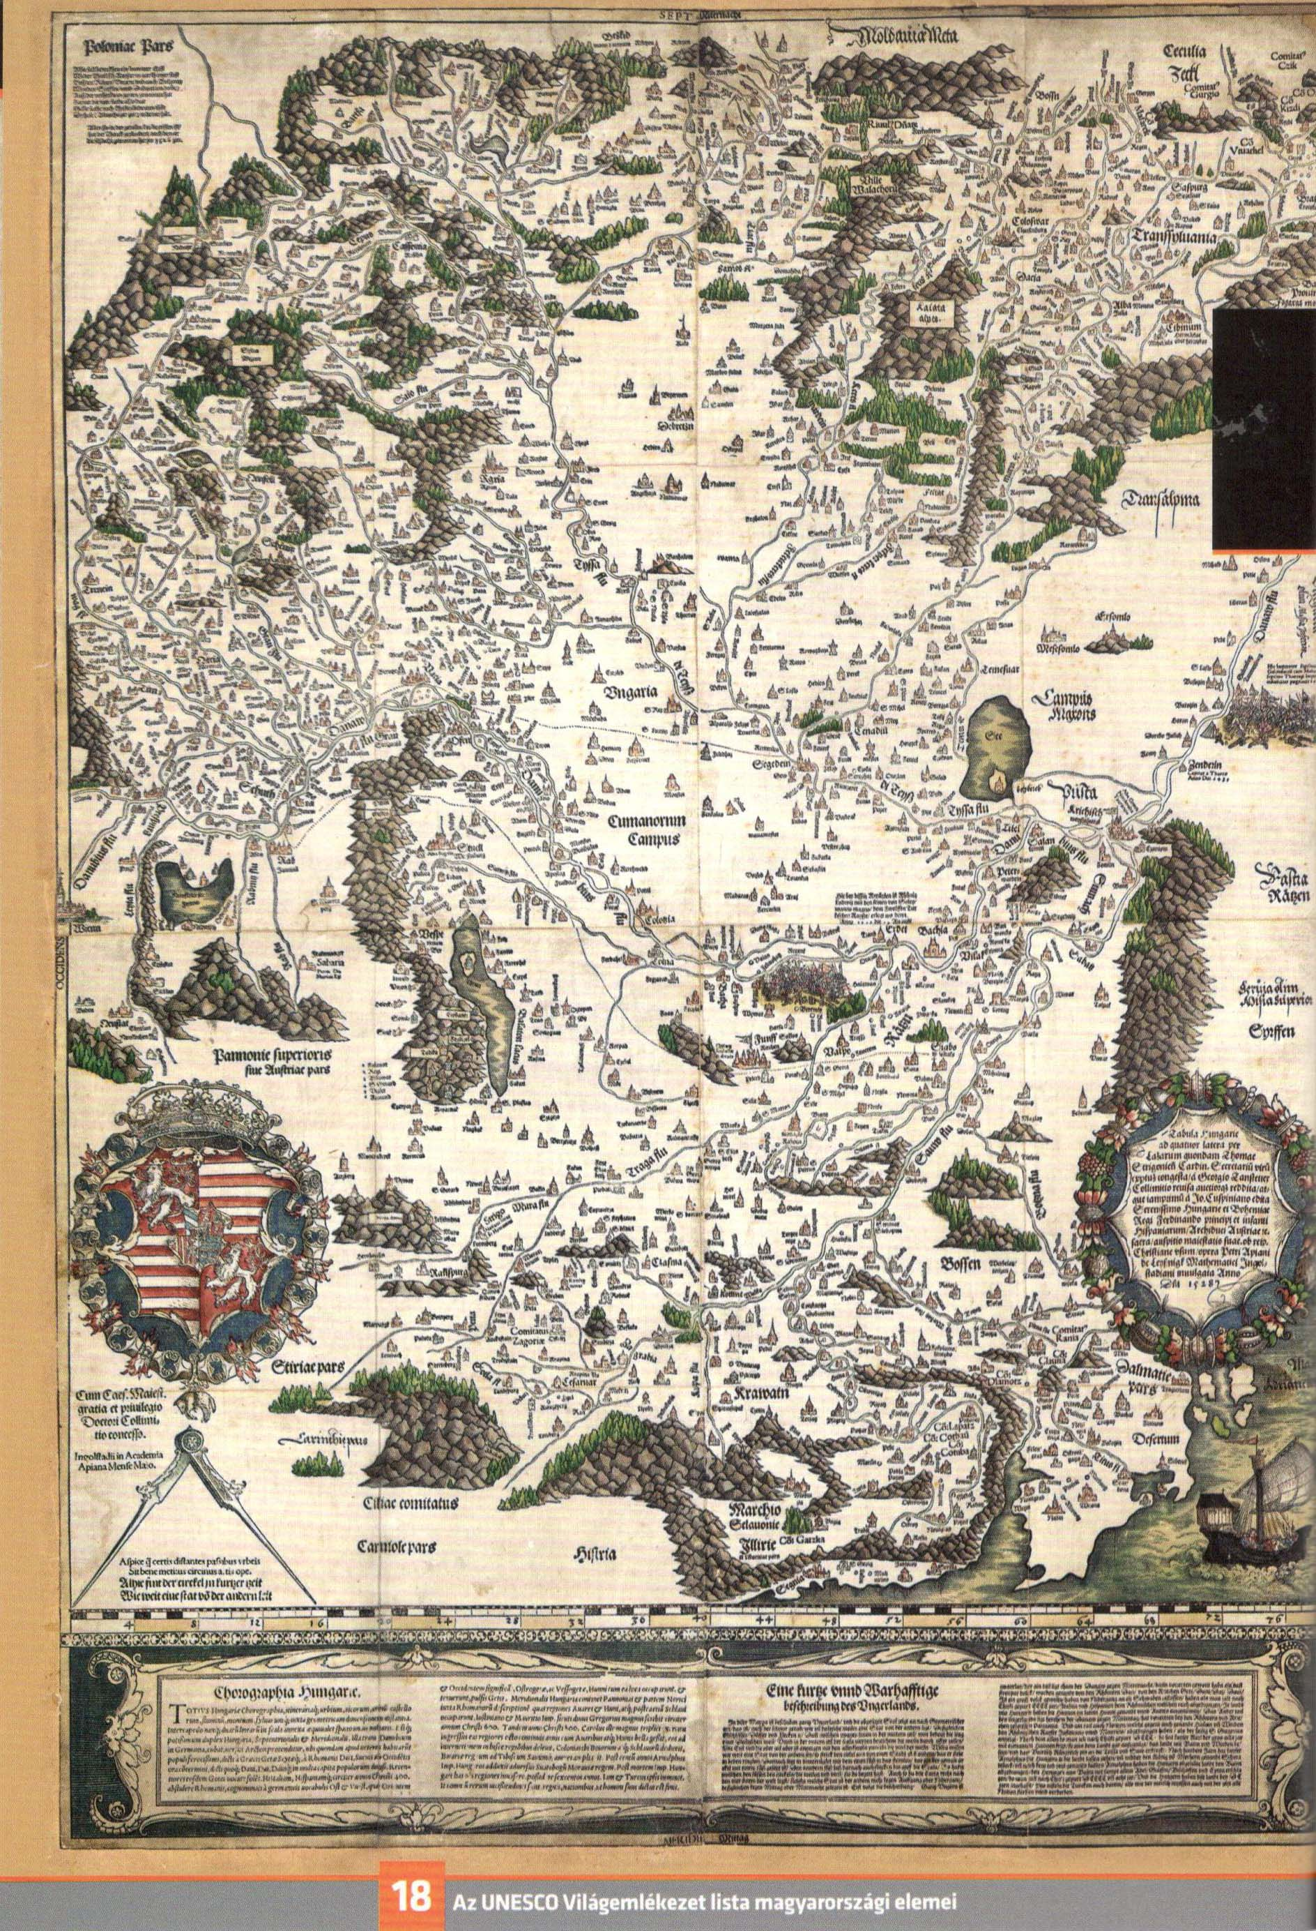
Tabula Hungariae
This document is a map representing faithfully and in much detail the structure of settlements that could be found on the territory of the Hungarian Kingdom (corresponding to the territory of modern Hungary, Slovakia and including parts of modern Austria, Ukraine, Romania, Serbia/Montenegro, Croatia and Slovenia). This representation has an even greater value due to the fact, that many settlements disappeared during the Turkish wars of the 16th century fought there. It should be noted, that for several centuries, research workers and interested persons had only an indirect knowledge of this document, up to the time, when it reappeared in the 1880’s, when the collector Sándor Apponyi acquired it. He later offered it (in 1924) to the National Library, which included it in the Library’s collection of rare and historical works.

Slide 13
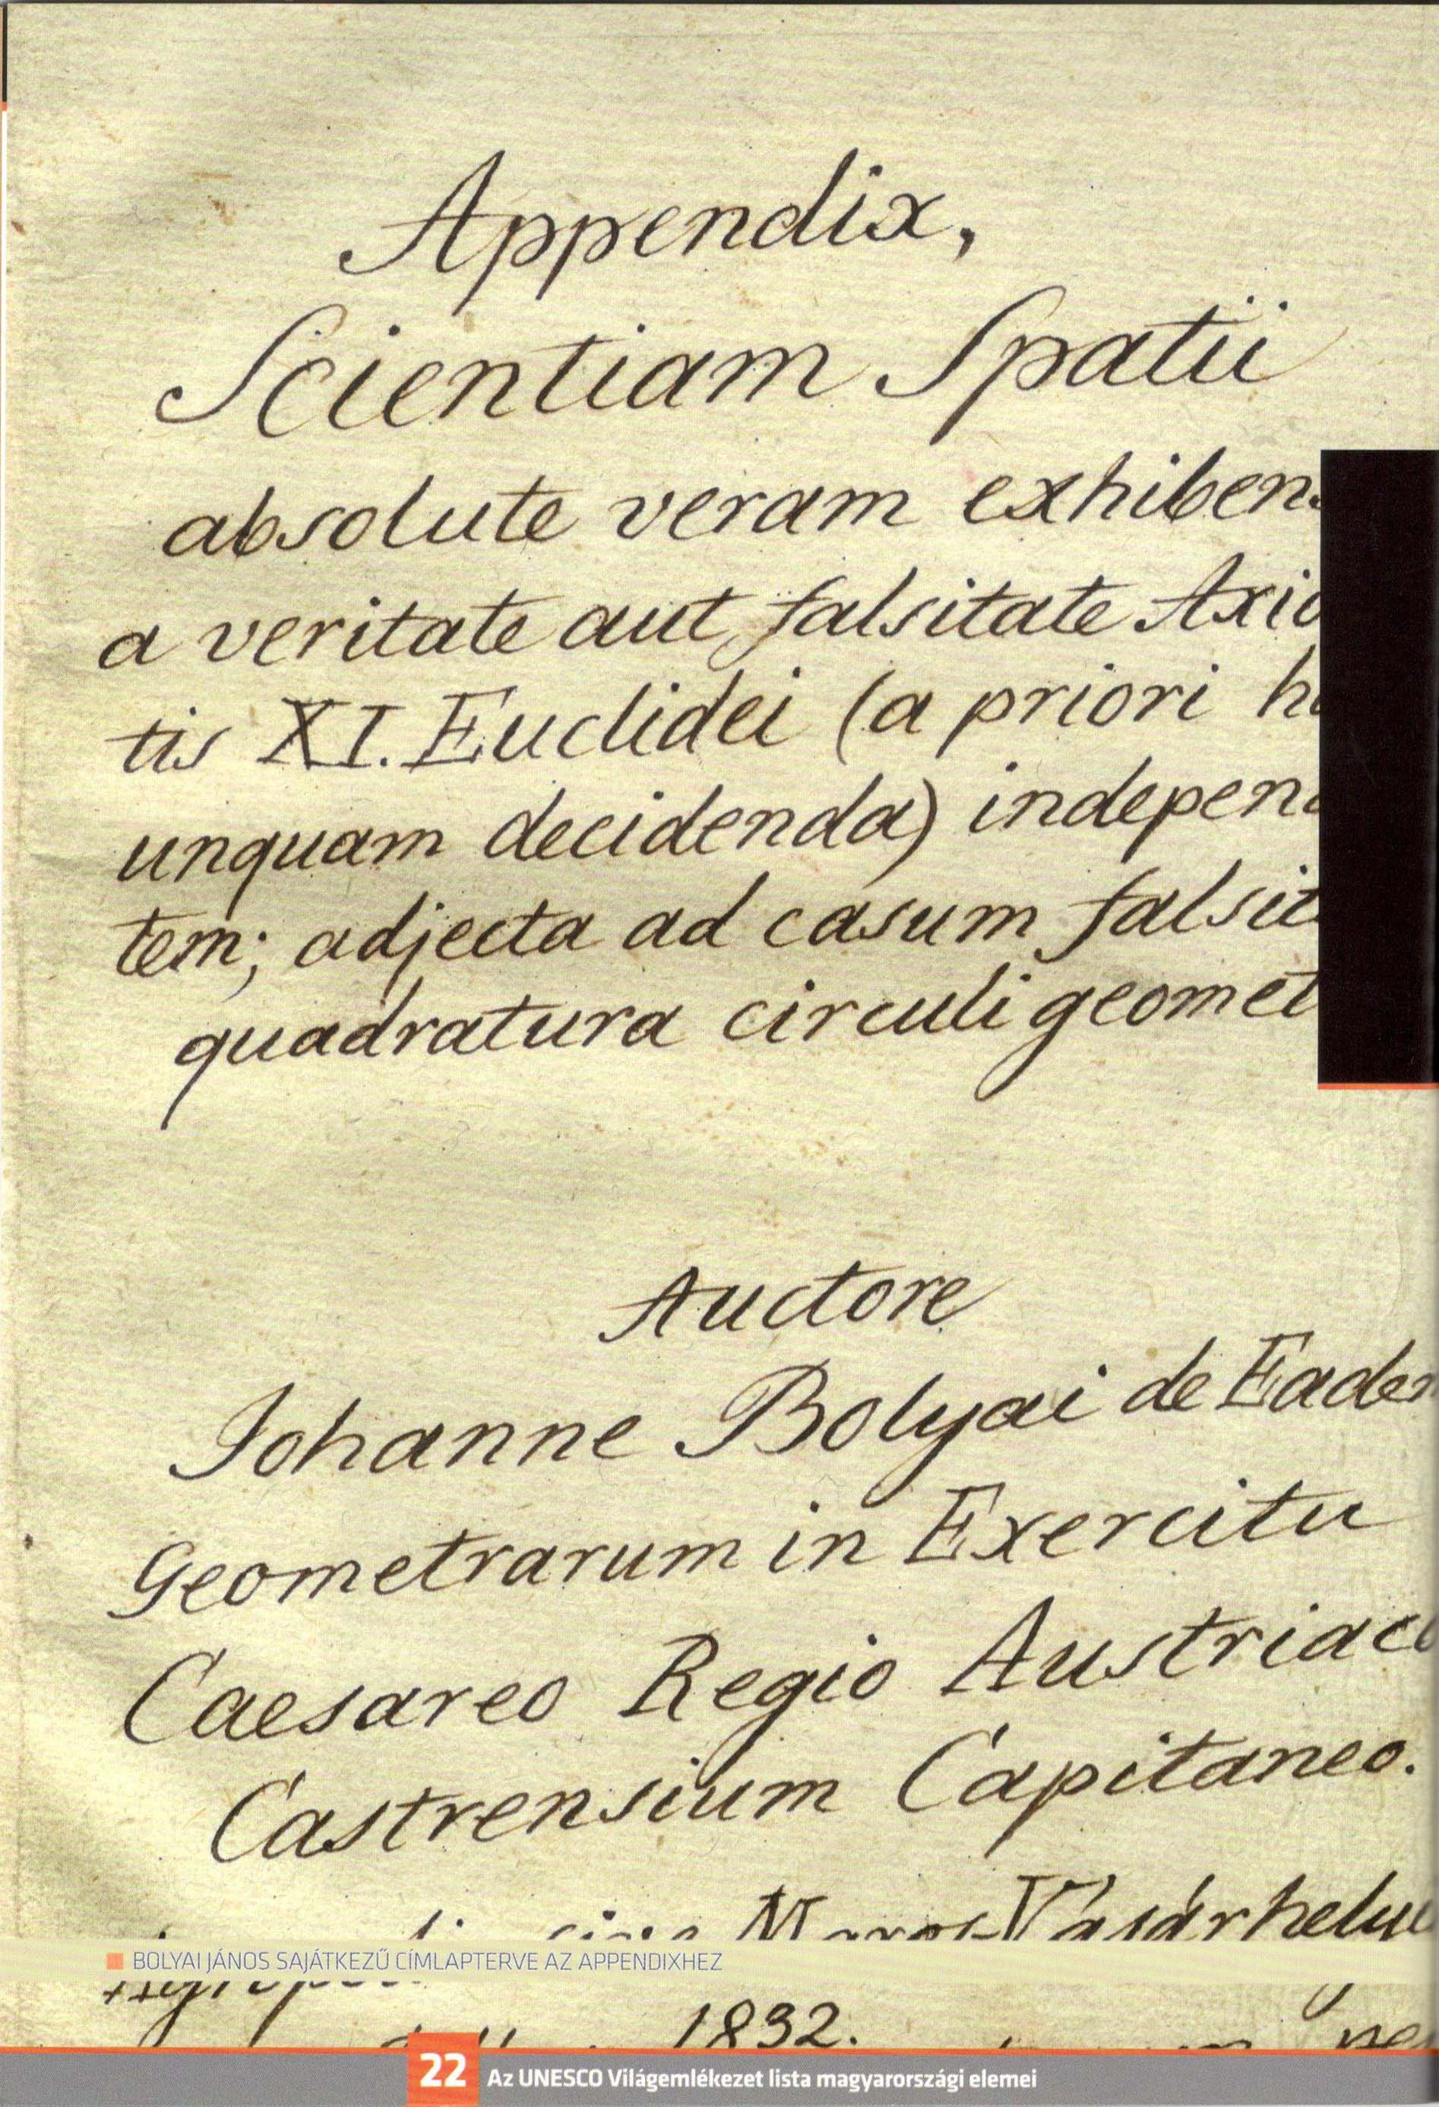
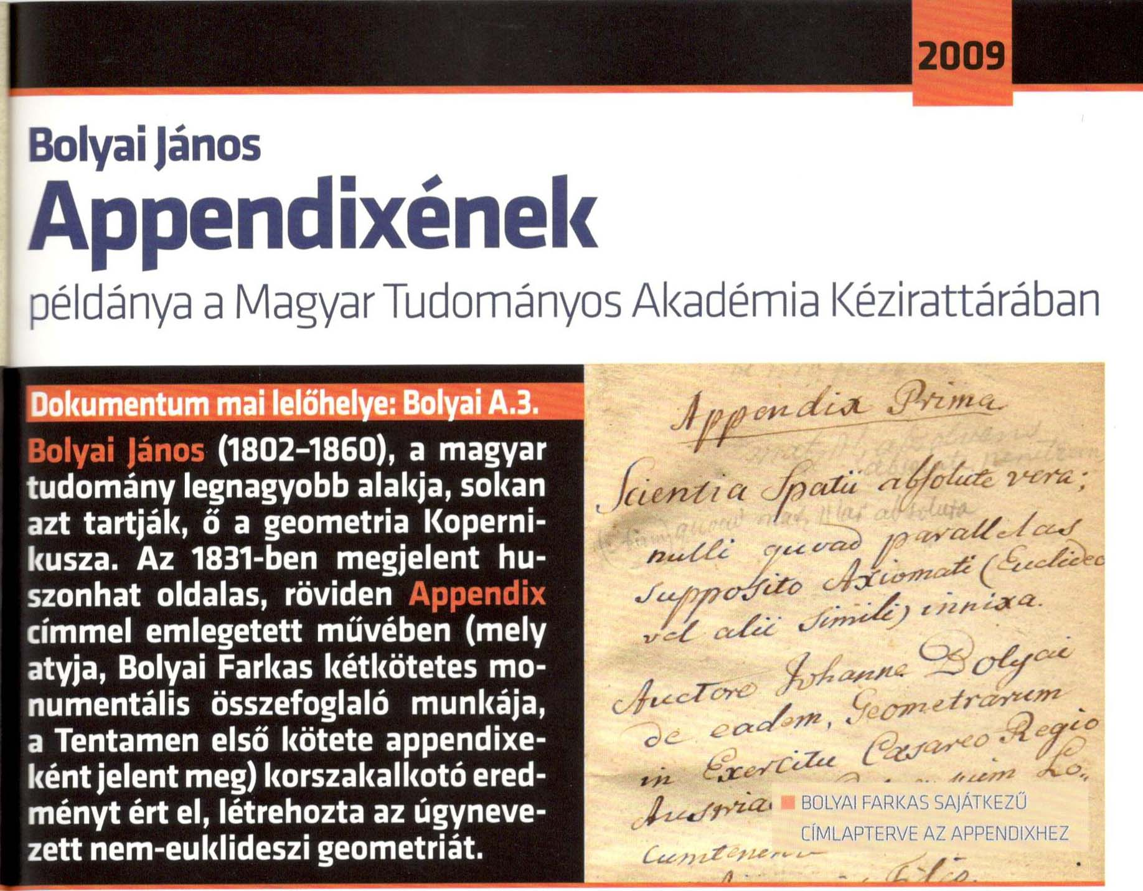
János Bolyai: Appendix, scientiam spatii absolute veram exhibens. Maros-Vásárhelyini, 1832
Title page of Appendix
Appendix is an outstanding document in the history of mathematics and human culture. It presents the solution of a more than two thousand year old problem in connection with parallel lines and the description of János Bolyai's discovery of non-Euclidean and the more general absolute geometries. Non-Euclidean geometry changed our thinking not only about geometry, but mathematics, in general, and paved the way for the creation of the modern physical theories of the twentieth century.

Slide 14
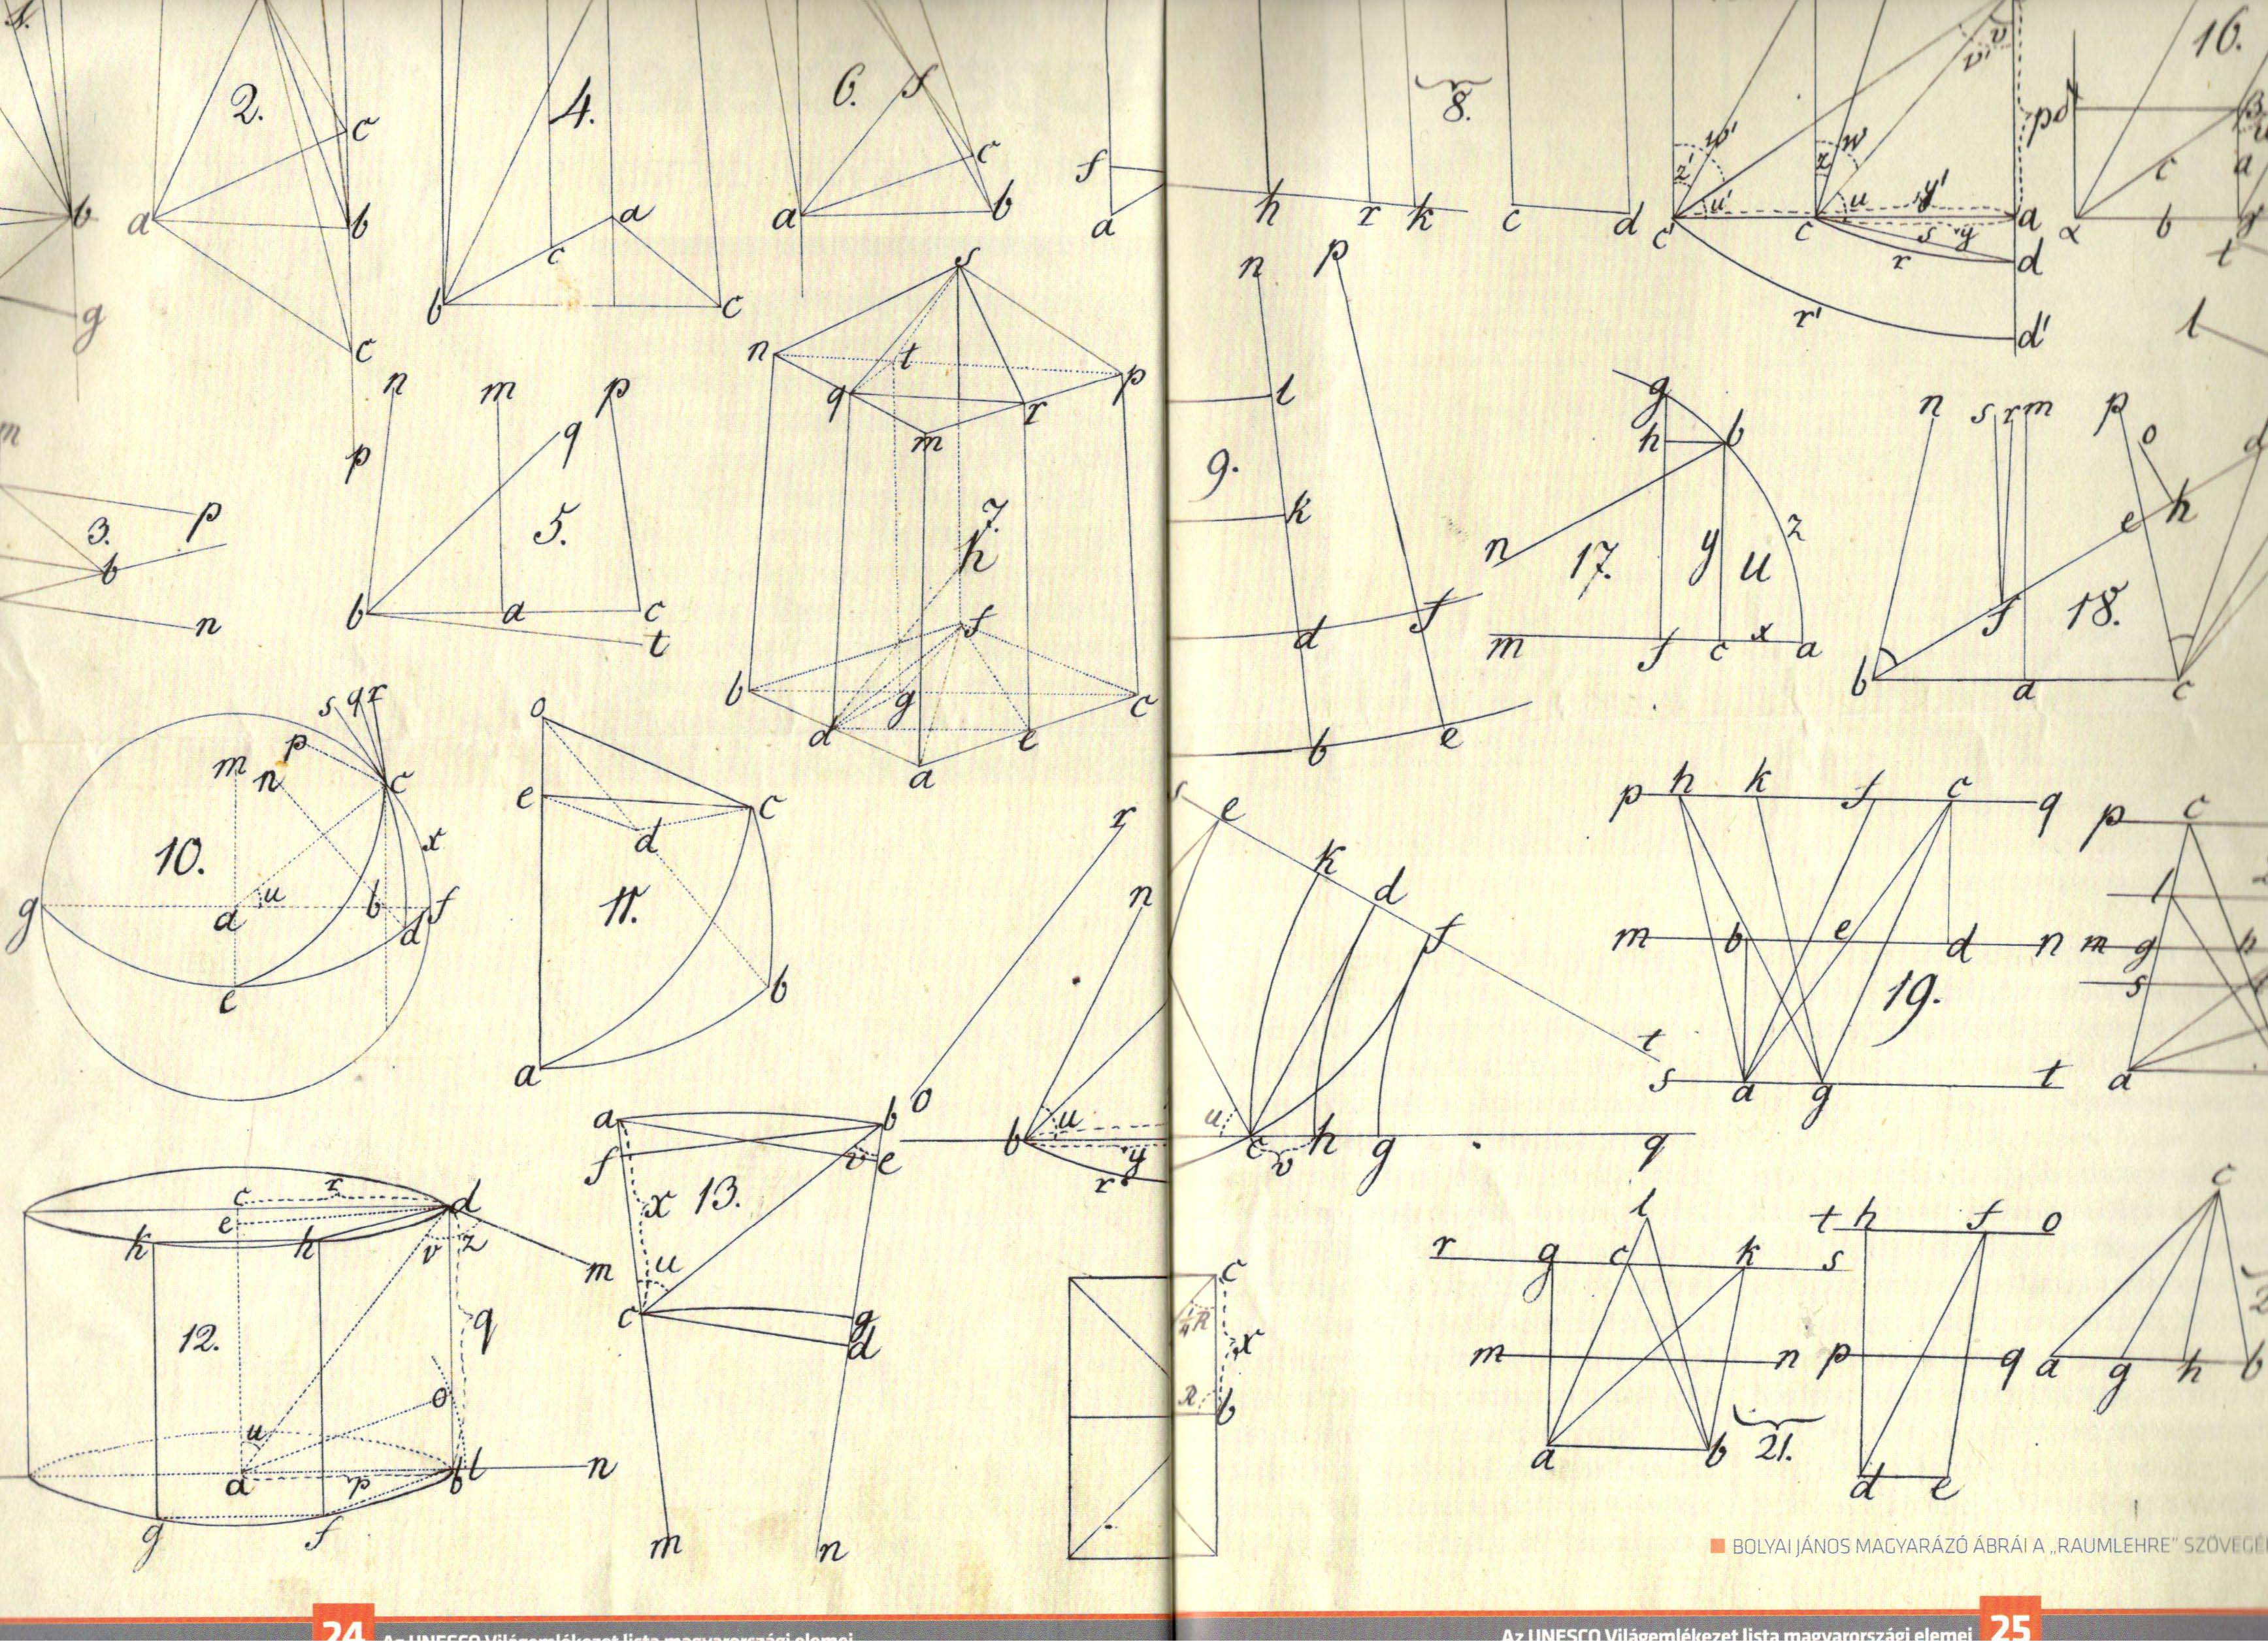
Diagrams for the „Space study (Raumlehre)

Slide 15
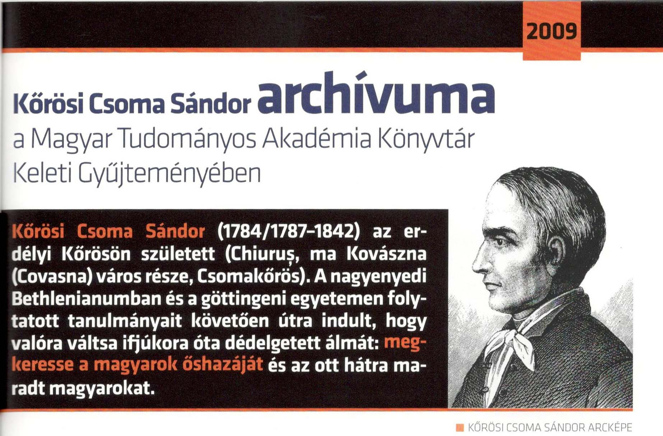
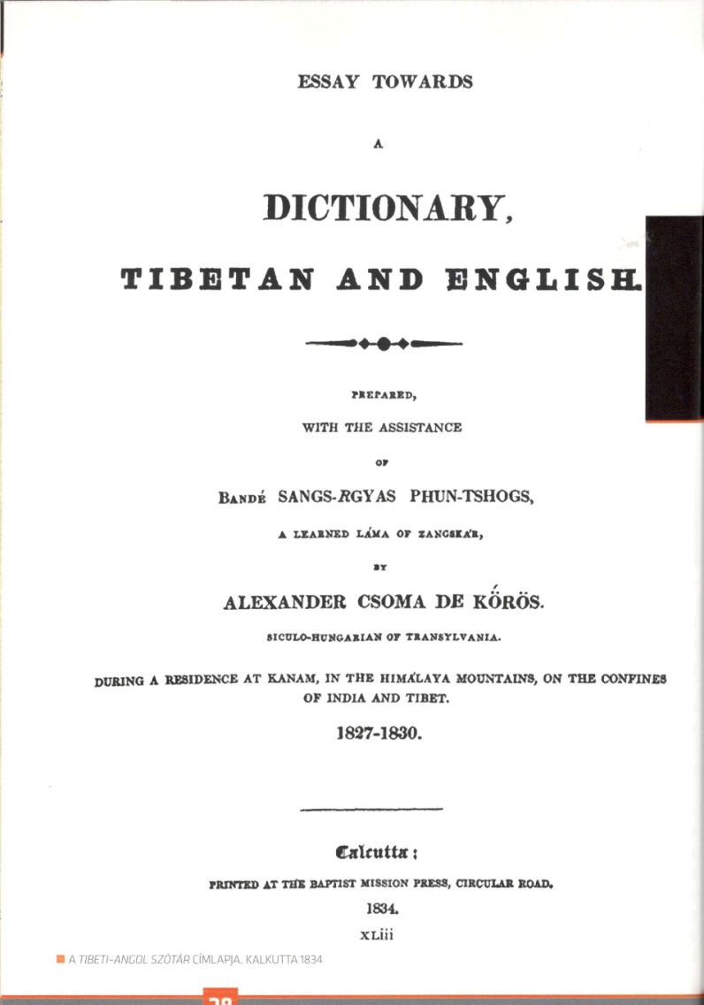
Csoma Archive of the Library of the Hungarian Academy of Sciences
Alexander Csoma de Kőrös (c. 1784-1842) a Hungarian scholar was the first to interpret the cultural heritage of the Tibetan people to Europe. He compiled the first Tibetan-English Dictionary of scientific value together with a Grammar of the Tibetan Language (1834). With his scholarly work he became the founder of Tibetan studies, a new discipline of Oriental studies.
Title page

Slide 16
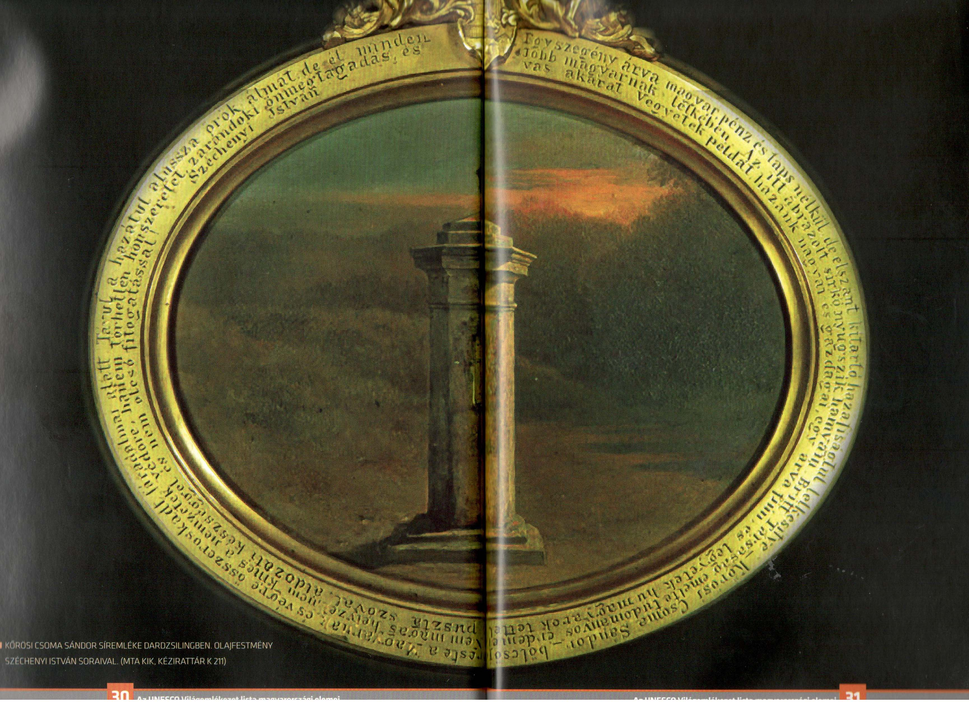
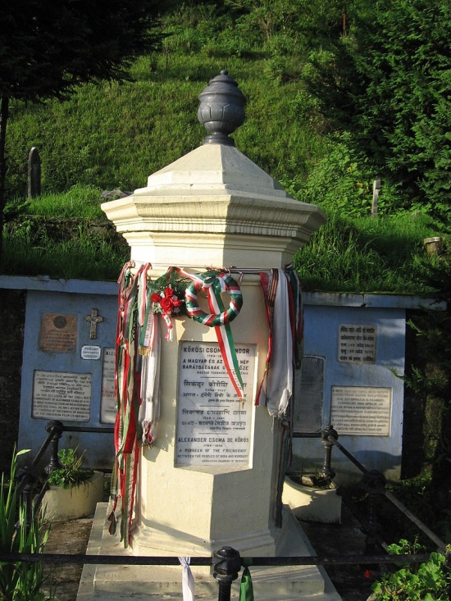
Painting of the thomb of Sándor Körösi in Darjeeling, India

Slide 17
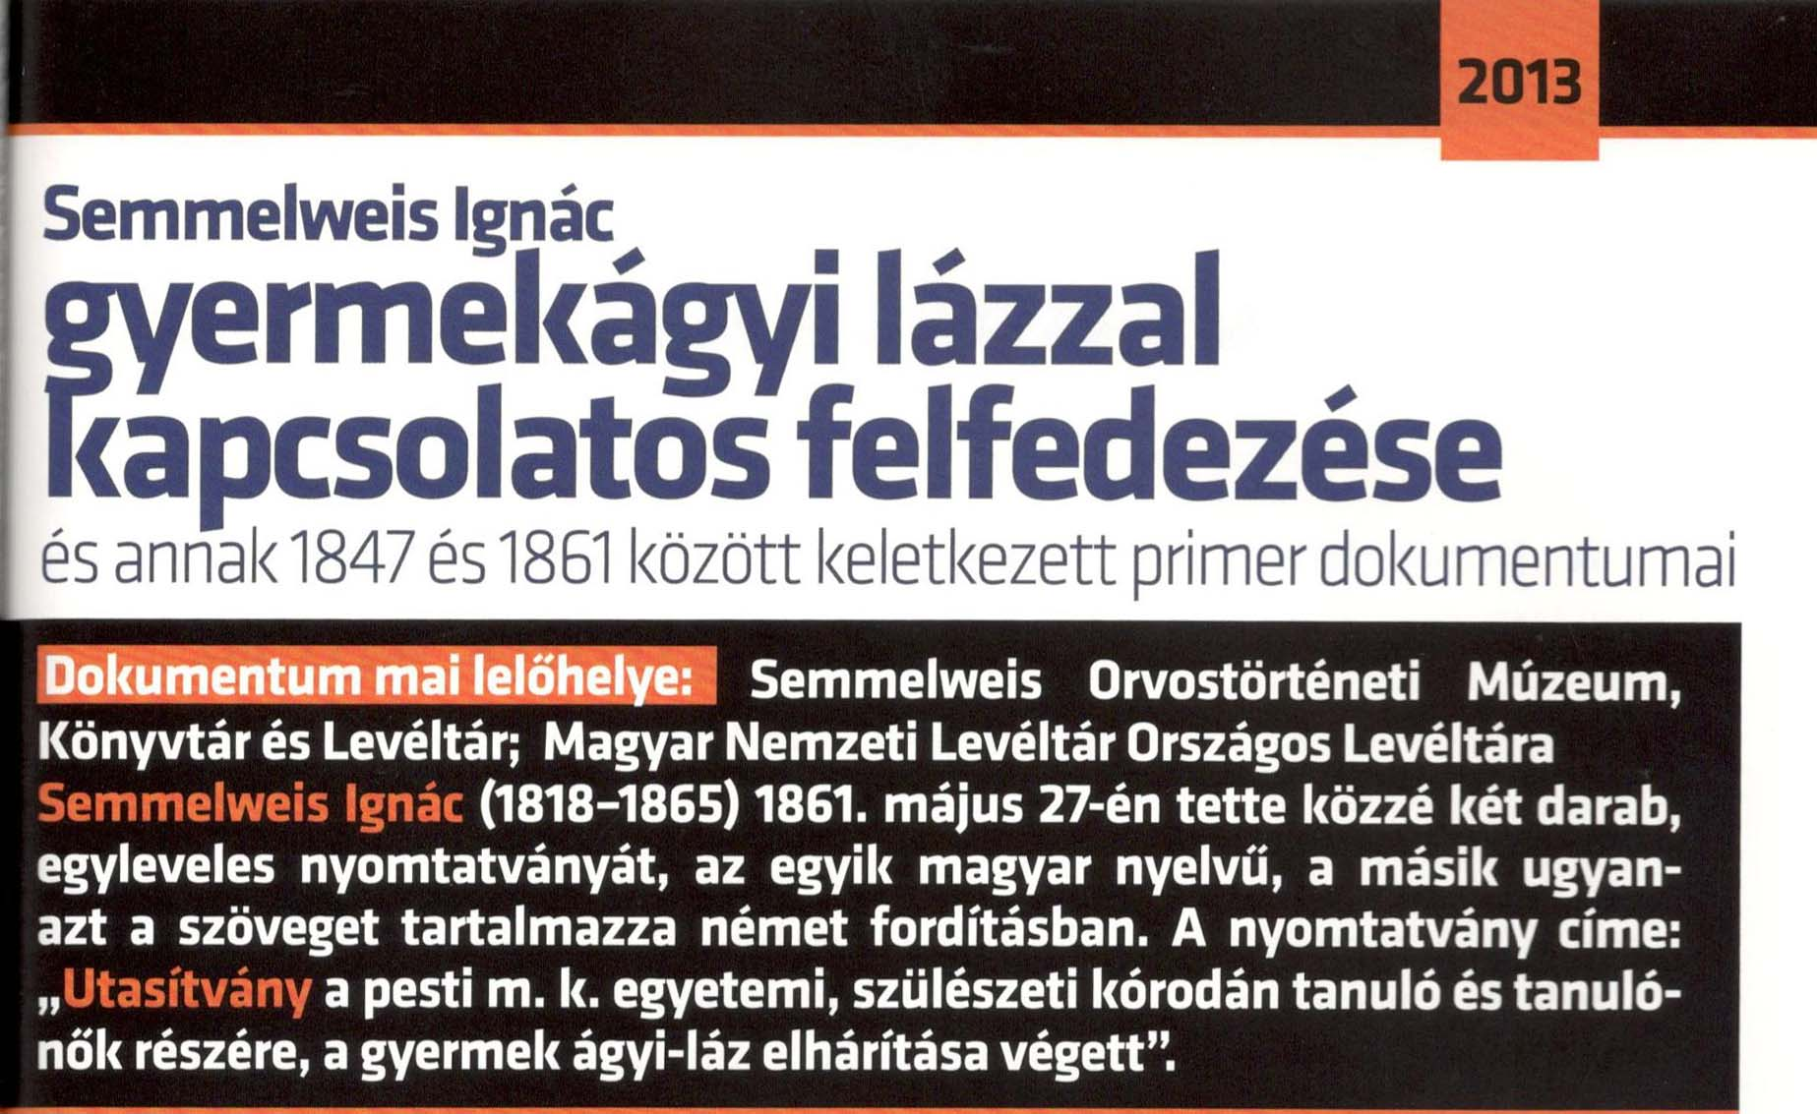
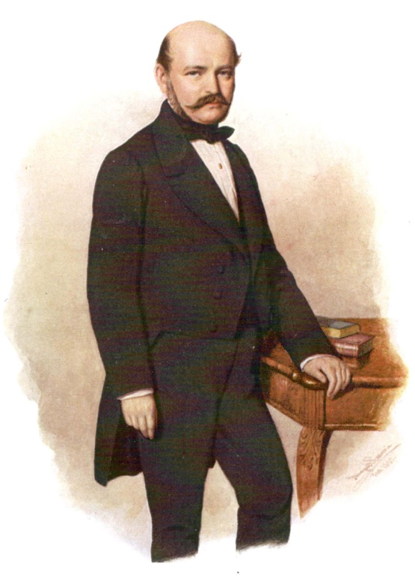
Semmelweis' discovery
A collection of printed materials on the discovery of the causes of childbed fever and elaborating aseptic prevention against it by Ignaz Philipp Semmelweis between 1847-1861. Semmelweis proved that puerperal fever having led earlier to particularly high mortality rates can be fully prevented. He determined the etiology of puerperal fever and, in doing so, also proved that the infection can be fully prevented if the persons getting into contact with the women giving birth thoroughly sterilize their hands. The prevention recommended by him is unique and was accepted relatively slowly in the world, although others also realized his achievement and studied this phenomenon.

Slide 18
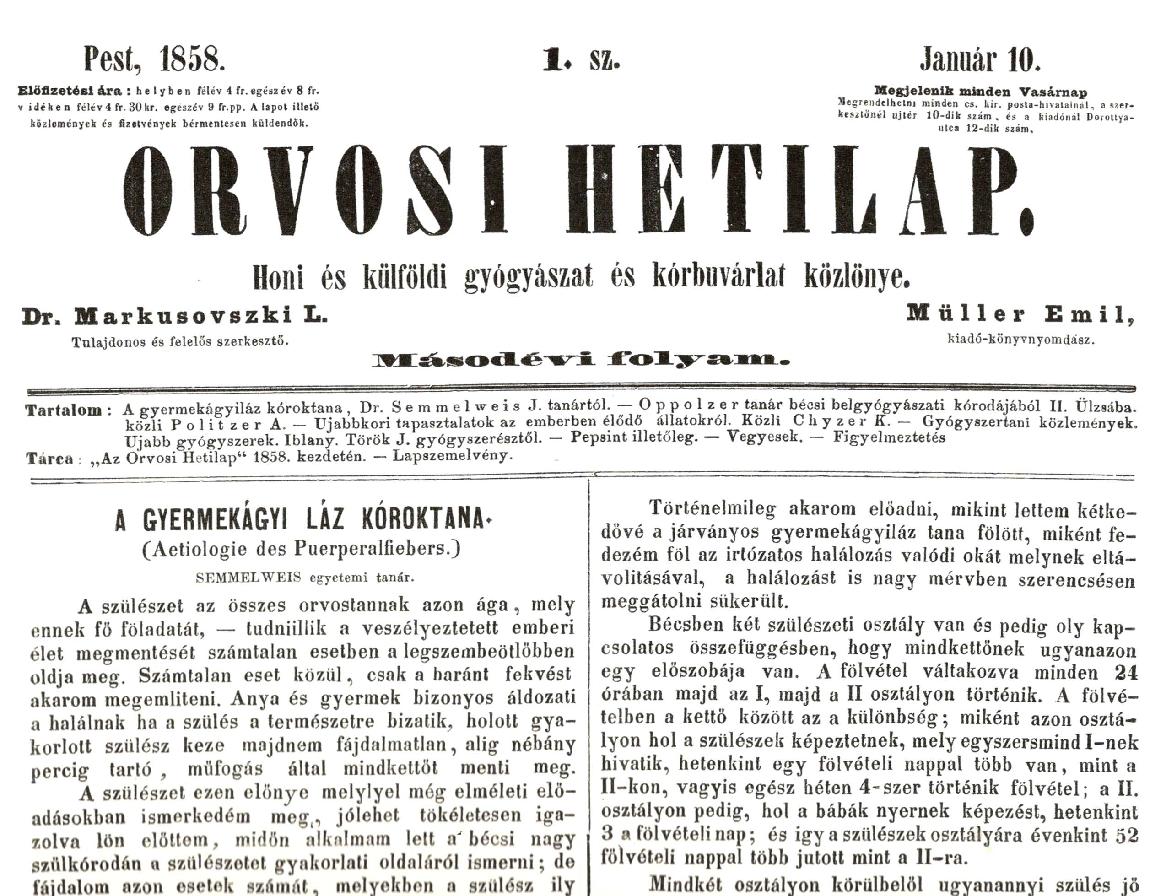

Slide 19
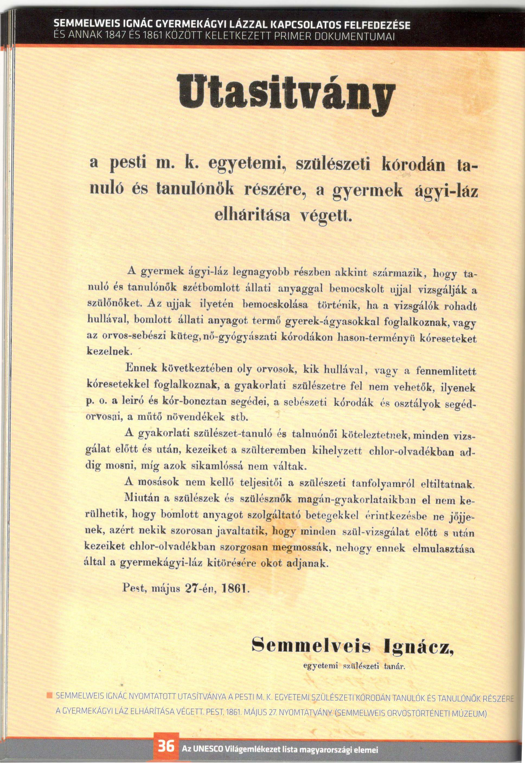
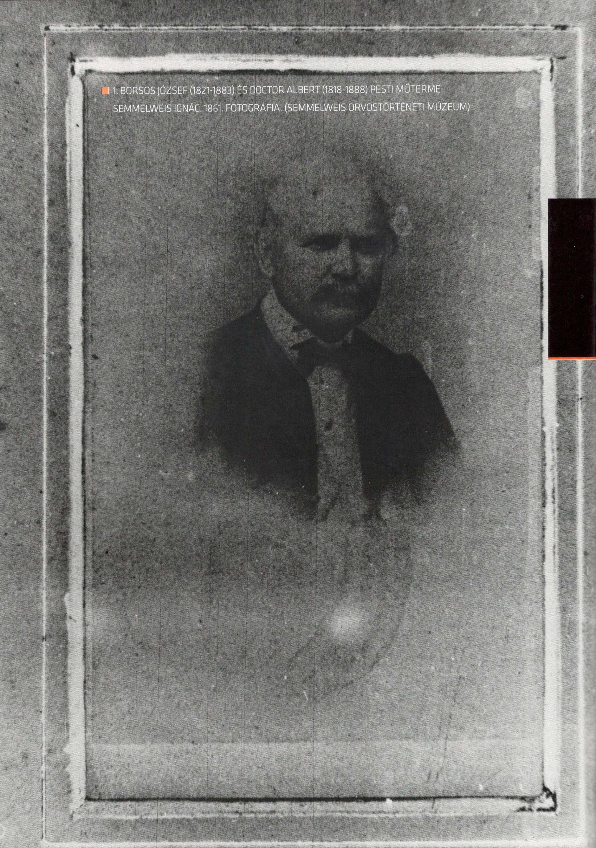
Photograpy of Ignac Semmelweis, 1861
Ordinance

Slide 20
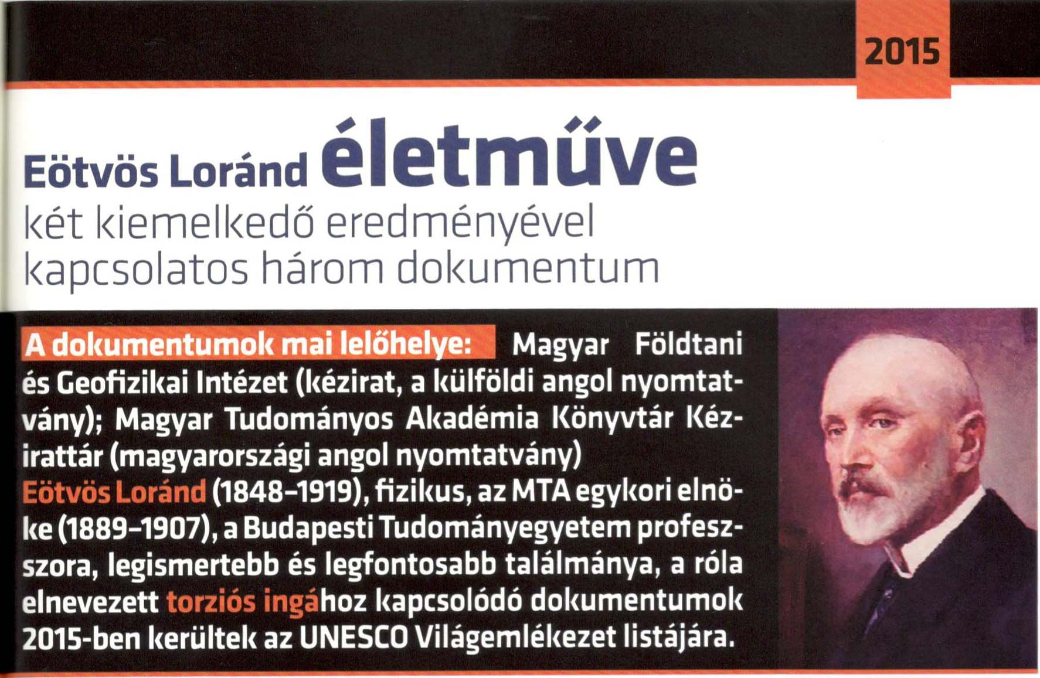
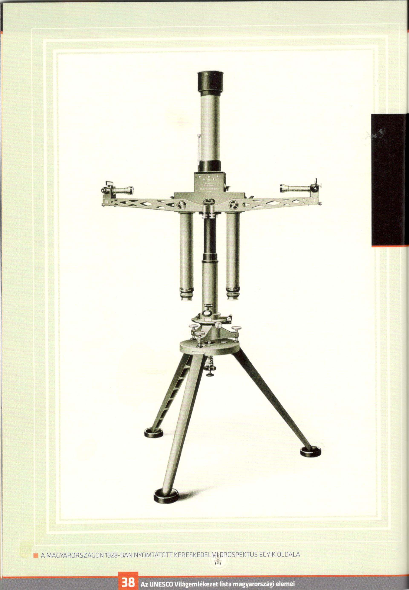
Eötvös is remembered today for his experimental work on gravity, in particular his study of the equivalence of gravitational and inertial mass (the so-called weak equivalence principle) and his study of the gravitational gradient on the Earth's surface. The weak equivalence principle plays a prominent role in realtivity theory and theEötvös experiment was cited by Albert Einstein in his 1916 paper The Foundation of the General Theory of Relativity. Measurements of the gravitational gradient are important in applied geophysics, such as the location of petroleum deposits. The CGS unit for gravitational gradient is named the eotvos in his honor.

